Slide 1
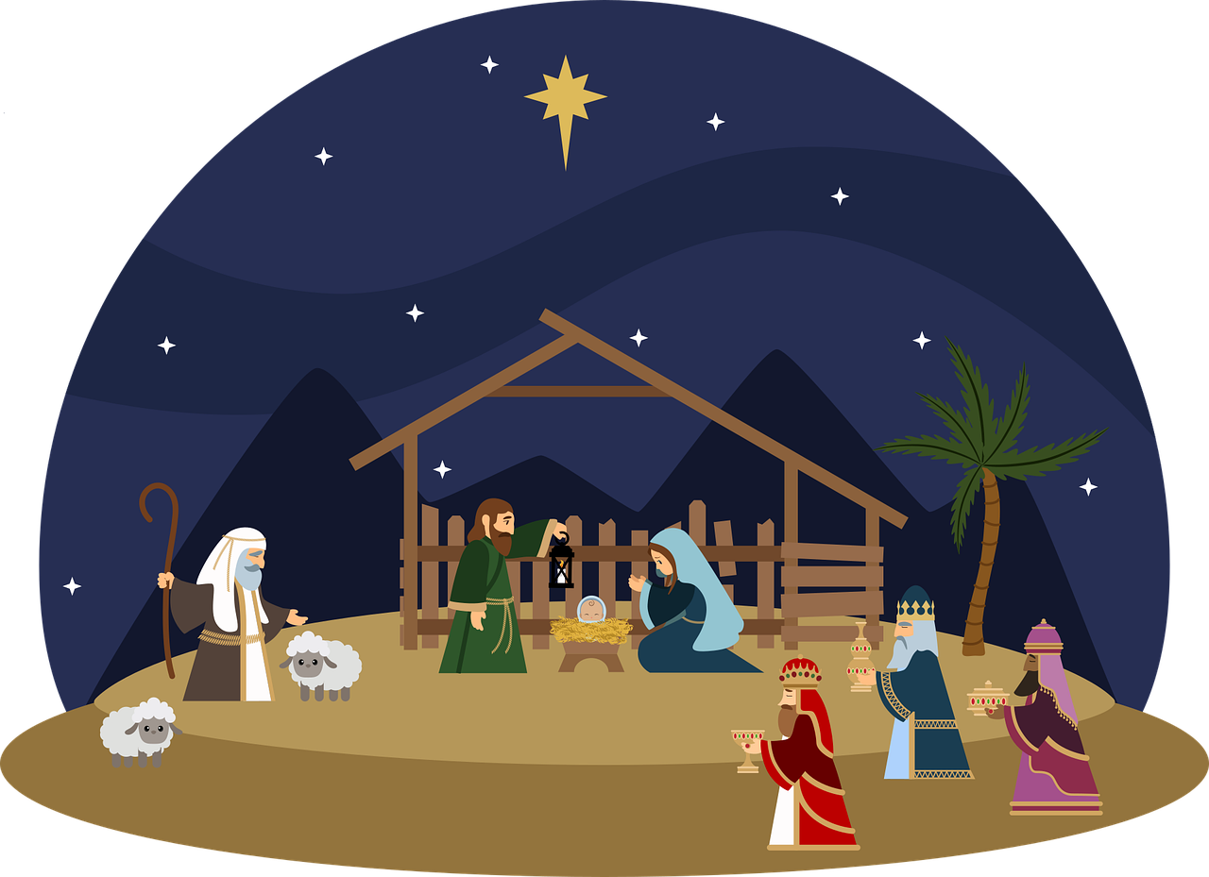
St Andrew’s URC Frognal
25 December 2024 10:30am
Led by elders
Entry of the Bible
Welcome and notices
Call to worship
Hymn 160 O come, all ye faithful
Prayers of Approach, Confession
Hymn 145 O little town of Bethlehem
Readings: Luke 2:1-20
John 1 :1-14
Hymn 164 Go tell it on the mountain
Address
Prayers of Intercession
Blessing of the offertory
Lord’s Prayer
Hymn 159 Hark, the herald angels sing
Blessing and Amen

Slide 2
Entry of the Bible
Welcome and Notices
Call to worship

Slide 3
Hymn 160 O Come, all ye Faithful
¹ O Come All Ye Faithful
Joyful and triumphant
O come ye, o come ye to Bethlehem
Come and behold Him
Born the king of angels
O come let us adore Him x3
Christ the Lord

Slide 4
² God of God, Light of Light,
Lo! He abhors not the Virgin's womb;
Very God, Begotten, not created.
O come let us adore Him x3
Christ the Lord
³ See how the shepherds summoned to His cradle,
Leaving their flocks, draw nigh to gaze!
We, too, will thither Bend our hearts' oblations.

Slide 5
⁴ Lo, star-led chieftains, Magi, Christ adoring,
Offer Him incense, gold and myrrh;
We to the Christ-child bring our hearts' oblations
O come let us adore Him x3
Christ the Lord
⁵ Sing, choirs of angels, sing in exultation,
O sing, all ye citizens of heaven above!
"Glory to God, In the highest!"

Slide 6
⁶ Yea, Lord, we greet Thee,
Born this happy morning,
Jesus, to Thee be all glory given;
Word of the Father,
Now in flesh appearing!
O come let us adore Him x3
Christ the Lord

Slide 7
Prayers of Approach
Confession

Slide 8
Luke 2:1-20
The Birth of Jesus
¹ In those days a decree went out from Emperor Augustus that all the world should be registered. ² This was the first registration and was taken while Quirinius was governor of Syria. ³ All went to their own towns to be registered. ⁴ Joseph also went from the town of Nazareth in Galilee to Judea, to the city of David called Bethlehem, because he was descended from the house and family of David.

Slide 9
⁵ He went to be registered with Mary, to whom he was engaged and who was expecting a child. ⁶ While they were there, the time came for her to deliver her child. ⁷ And she gave birth to her firstborn son and wrapped him in bands of cloth, and laid him in a manger, because there was no place for them in the inn.

Slide 10
The Shepherds and the Angels
⁸ In that region there were shepherds living in the fields, keeping watch over their flock by night. ⁹ Then an angel of the Lord stood before them, and the glory of the Lord shone around them, and they were terrified. ¹⁰ But the angel said to them, ‘Do not be afraid; for see - I am bringing you good news of great joy for all the people: ¹¹ to you is born this day in the city of David a Saviour, who is the Messiah, the Lord.

Slide 11
¹² This will be a sign for you: you will find a child wrapped in bands of cloth and lying in a manger.’ ¹³ And suddenly there was with the angel a multitude of the heavenly host, praising God and saying,
¹⁴ ‘Glory to God in the highest heaven,
and on earth peace among those whom he favours!’
¹⁵ When the angels had left them and gone into heaven, the shepherds said to one another, ‘Let us go now to Bethlehem and see this thing that has taken place, which the Lord has made known to us.’

Slide 12
¹⁶ So they went with haste and found Mary and Joseph, and the child lying in the manger. ¹⁷ When they saw this, they made known what had been told them about this child; ¹⁸ and all who heard it were amazed at what the shepherds told them. ¹⁹ But Mary treasured all these words and pondered them in her heart. ²⁰ The shepherds returned, glorifying and praising God for all they had heard and seen, as it had been told them.

Slide 13
Hymn 146 Away in a manger
Away in a manger, no crib for a bed,
the little Lord Jesus laid down his sweet head.
The stars in the bright sky looked down where he lay,
the little Lord Jesus asleep on the hay

Slide 14
Be near me, Lord Jesus; I ask you to stay
close by me for ever, and love me, I pray.
Bless all the world's children in your
tender care,
and fit us for heaven to live with you there

Slide 15
John 1:1-14
The Word Became Flesh
¹ In the beginning was the Word, and the Word was with God, and the Word was God. ² He was in the beginning with God. ³ All things came into being through him, and without him not one thing came into being. What has come into being ⁴ in him was life, and the life was the light of all people. ⁵ The light shines in the darkness, and the darkness did not overcome it.

Slide 16
⁶ There was a man sent from God, whose name was John. ⁷ He came as a witness to testify to the light, so that all might believe through him. ⁸ He himself was not the light, but he came to testify to the light. ⁹ The true light, which enlightens everyone, was coming into the world.
¹⁰ He was in the world, and the world came into being through him; yet the world did not know him.

Slide 17
¹¹ He came to what was his own, and his own people did not accept him. ¹² But to all who received him, who believed in his name, he gave power to become children of God, ¹³ who were born, not of blood or of the will of the flesh or of the will of man, but of God.
¹⁴ And the Word became flesh and lived among us, and we have seen his glory, the glory as of a father’s only son, full of grace and truth.

Slide 18
Prayers for the church & the world

Slide 19
Hymn 188 Born in the night
Born in the night, Mary's child,
a long way from your home:
coming in need, Mary's child,
born in a borrowed room.

Slide 20
² Clear shining Light,
Mary's child,
your face lights up our way;
light of the world,
Mary's child,
dawn on our darkened day.

Slide 21
³ Truth of our life,
Mary's child,
you tell us God is good;
prove it is true,
Mary's child,
go to your cross of wood.

Slide 22
⁴ Hope of the world,
Mary's child,
you're coming soon to reign;
King of the earth,
Mary's child,
walk in our streets again.

Slide 23
Address

Slide 24
Hymn 164 Go tell it on the mountain
Go tell it on the mountain,
over the hills, and ev'rywhere;
go, tell it on the mountain
that Jesus Christ is born.
¹ While shepherds kept their watching
o’er silent flocks by night,
behold, throughout the heavens
there shone a holy light.

Slide 25
Go tell it on the mountain,
over the hills, and ev'rywhere;
go, tell it on the mountain
that Jesus Christ is born.
² The shepherds feared and trembled
when lo, above the earth
rang out the angel chorus
that hailed our Saviour’s birth.

Slide 26
Go tell it on the mountain,
over the hills, and ev'rywhere;
go, tell it on the mountain
that Jesus Christ is born.
³ Down in a lowly manger
the humble Christ was born,
and God sent us salvation
that blessed Christmas morn. Go …

Slide 27
Blessing and Amen
If you are available, please feel free to remain online to chat for fellowship.

Slide 28
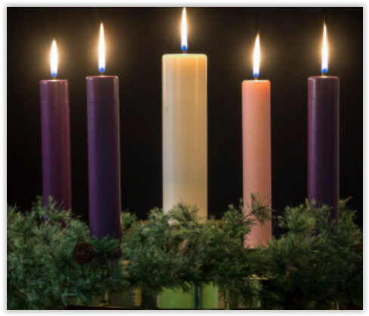

Slide 29
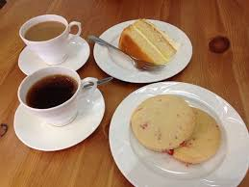
Our Fellowship Continues apart
If you are available, please feel free to remain online to chat.

