Slide 1
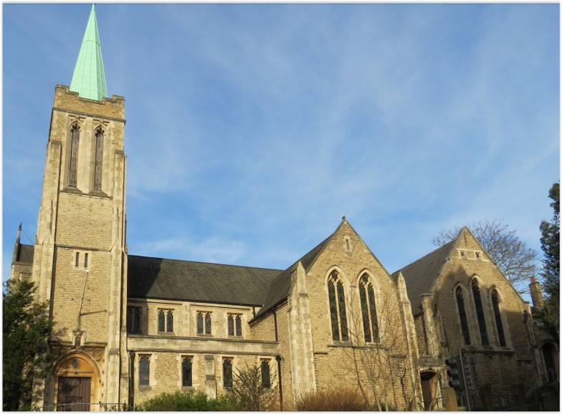
Entry of the Bible
Opening Prayer
Hymn 220 O sacred head, sore wounded
Reading Isaiah 52: 13-53: 1
Silent reflection
Reading Isaiah 53: 3-9
Choir Anthem
Reading Mark 14. 53-64
Silent reflection
Reading Mark 15. 22-39
Hymn 223 There is a green hill far away
Prayers
Hymn 218 When my love to God grows weak
Closing Prayer
Readings: NRSV
All hymns are from Rejoice and Sing. CCLI 1239051
St Andrew’s URC Frognal
18 April 2025 11:00am
Good Friday

Slide 2
Entry of the Bible
Opening Prayer

Slide 3
Hymn 220 O sacred Head, sore wounded
1 O sacred Head, sore wounded,
with grief & shame weighed down;
O royal head surrounded
with thorns, thy only crown;
O Lod of life and glory,
what bliss till now was thine!
I read the wondrous story
I joy to call thee mine.

Slide 4
² What thou, my Lord, hast suffered
was all for sinner’s gain;
mine, mine was the transgression,
but thine the deadly pain.
By this, thy bitter passion,
Good Shepherd, think on me;
vouchsafe to me compassion,
unworthy though I be.

Slide 5
³ For this, thy dying sorrow,
O Jesus, dearest Friend,
what language shall I borrow
to thank thee without end?
O make me thine for ever,
and should I fainting be,
Lord, let me never, never
outlive my love to thee.

Slide 6
⁴ Be near when I am dying,
and, show thy cross to me
that I, for succour flying,
may rest my eyes on thee.
My Lord, thy grace receiving,
let faith my fears dispel,
that I may die believing.
and in thee, Lord, die well.

Slide 7
Isaiah 52:13 – 53:1
The Suffering Servant
¹³ See, my servant shall prosper;
he shall be exalted and lifted up
and shall be very high.
¹⁴ Just as there were many who were astonished at him
- so marred was his appearance, beyond human semblance,
and his form beyond that of mortals -

Slide 8
¹⁵ so he shall startle many nations;
kings shall shut their mouths because of him,
for that which had not been told them they shall see,
and that which they had not heard they shall contemplate.
^{53:1} Who has believed what we have heard?
And to whom has the arm of the Lord been revealed?

Slide 9
Silent reflection

Slide 10
Isaiah 53:3-9
³ He was despised and rejected by others;
a man of suffering[c] and acquainted with infirmity,
and as one from whom others hide their faces
he was despised, and we held him of no account.

Slide 11
⁴ Surely he has borne our infirmities
and carried our diseases,
yet we accounted him stricken,
struck down by God, and afflicted.
⁵ But he was wounded for our transgressions,
crushed for our iniquities;
upon him was the punishment that made us whole,
and by his bruises we are healed.

Slide 12
⁶ All we like sheep have gone astray;
we have all turned to our own way,
and the Lord has laid on him
the iniquity of us all.
⁷ He was oppressed, and he was afflicted,
yet he did not open his mouth;
like a lamb that is led to the slaughter
and like a sheep that before its shearers is silent,
so he did not open his mouth.

Slide 13
⁸ By a perversion of justice he was taken away.
Who could have imagined his future?
For he was cut off from the land of the living,
stricken for the transgression of my people.
⁹ They made his grave with the wicked
and his tomb with the rich,
although he had done no violence,
and there was no deceit in his mouth.

Slide 14
Choir Anthem

Slide 15
Mark 14:53-64
Jesus before the Council
⁵³ They took Jesus to the high priest, and all the chief priests, the elders, and the scribes were assembled. ⁵⁴ Peter had followed him at a distance, right into the courtyard of the high priest, and he was sitting with the guards, warming himself at the fire.

Slide 16
⁵⁵ Now the chief priests and the whole council were looking for testimony against Jesus to put him to death, but they found none. ⁵⁶ For many gave false testimony against him, and their testimony did not agree. ⁵⁷ Some stood up and gave false testimony against him, saying, ⁵⁸ “We heard him say, ‘I will destroy this temple that is made with hands, and in three days I will build another, not made with hands.’ ”

Slide 17
⁵⁹ But even on this point their testimony did not agree. ⁶⁰ Then the high priest stood up before them and asked Jesus, “Have you no answer? What is it that they testify against you?” ⁶¹ But he was silent and did not answer. Again the high priest asked him, “Are you the Messiah, the Son of the Blessed One?”

Slide 18
⁶² Jesus said, “I am, and
‘you will see the Son of Man
seated at the right hand of the Power’
and ‘coming with the clouds of heaven.’ ”
⁶³ Then the high priest tore his clothes and said, “Why do we still need witnesses? ⁶⁴ You have heard his blasphemy! What is your decision?” All of them condemned him as deserving death.

Slide 19
Silent reflection

Slide 20
Mark 15:22-39
²² Then they brought Jesus to the place called Golgotha (which means Place of a Skull). ²³ And they offered him wine mixed with myrrh, but he did not take it. ²⁴ And they crucified him and divided his clothes among them, casting lots to decide what each should take. ²⁵ It was nine o’clock in the morning when they crucified him.

Slide 21
²⁶ The inscription of the charge against him read, “The King of the Jews.” ²⁷ And with him they crucified two rebels, one on his right and one on his left.
(²⁸ And the scripture was fulfilled that says, “And he was counted among the lawless.”)
²⁹ Those who passed by derided him, shaking their heads and saying, “Aha! You who would destroy the temple and build it in three days, ³⁰ save yourself, and come down from the cross!”

Slide 22
³¹ In the same way the chief priests, along with the scribes, were also mocking him among themselves and saying, “He saved others; he cannot save himself. ³² Let the Messiah, the King of Israel, come down from the cross now, so that we may see and believe.” Those who were crucified with him also taunted him.

Slide 23
The Death of Jesus
³³ When it was noon, darkness came over the whole land until three in the afternoon. ³⁴ At three o’clock Jesus cried out with a loud voice, “Eloi, Eloi, lema sabachthani?” which means, “My God, my God, why have you forsaken me?” ³⁵ When some of the bystanders heard it, they said, “Listen, he is calling for Elijah.”

Slide 24
³⁶ And someone ran, filled a sponge with sour wine, put it on a stick, and gave it to him to drink, saying, “Wait, let us see whether Elijah will come to take him down.” ³⁷ Then Jesus gave a loud cry and breathed his last. ³⁸ And the curtain of the temple was torn in two, from top to bottom. ³⁹ Now when the centurion who stood facing him saw that in this way he breathed his last, he said, “Truly this man was God’s Son!”

Slide 25
Hymn 223 There is a green hill far away
¹ There is a green hill far away,
outside a city wall,
where our dear Lord was crucified
who died to save us all.

Slide 26
² We may not know, we cannot tell,
what pains he had to bear,
but we believe it was for us
he hung and suffered there.

Slide 27
³ He died that we might be forgiven,
he died to make us good,
that we might go at last to heaven,
saved by his precious blood.

Slide 28
⁴ O dearly, dearly has he loved!
And we must love him too,
and trust in his redeeming blood,
and try his works to do.

Slide 29
Prayers

Slide 30
Hymn 218 When my love to God grows weak
¹ When my love to God grows weak,
when for deeper faith I seek,
then in thought I go to thee,
garden of Gethsemane.

Slide 31
² There I walk amid the shades
while the lingering twilight fades,
see that suffering, friendless one
weeping, praying there alone.

Slide 32
³ When my will to love grows weak,
when for stronger faith I seek,
hill of Calvary, I go
to thy scenes of fear and woe.

Slide 33
⁴ There behold his agony,
suffered on the bitter tree:
see his anguish, see his faith,
love triumphant still in death.

Slide 34
⁵ Then to life I turn again,
learning all the worth of pain,
learning all the might that lies
in a full self-sacrifice.

Slide 35
⁶ And I praise with firmer faith
Christ who vanquished pain and death,
and to Christ enthroned above
raise my song of selfless love.

Slide 36
Closing Prayer

Slide 37
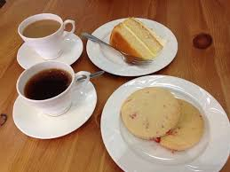
Our Fellowship Continues apart
If you are available, please feel free to remain online to chat.

