Slide 1
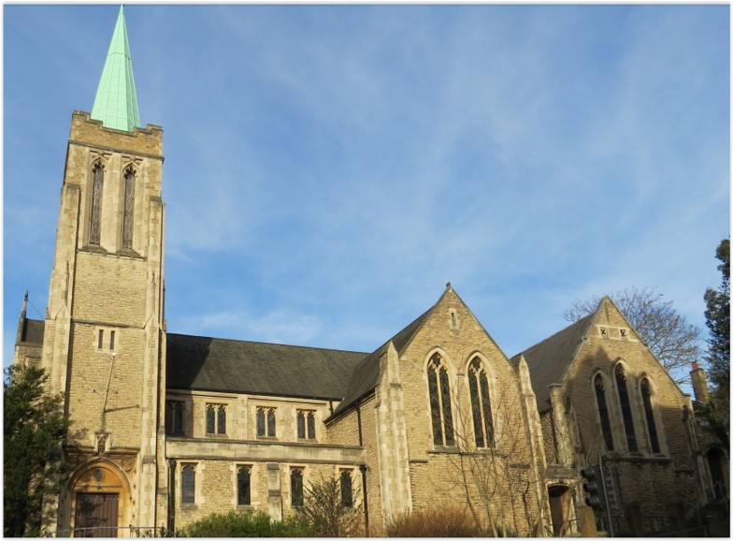
Entry of the Bible. Welcome and notices
Introit. Call to worship.
Hymn 74 Praise to the Lord, the Almighty, the King of creation!
Prayers of approach and confession
Introduction
Hymn 687 (Psalm 36)
Readings: Psalm 23. Revelation 7:9-10, 16-17
Hymn 293 Ye servants of God, your Master proclaim
Reading: John Ch 10 v 22-30
Anthem
Sermon
Hymn 552 The King of love my Shepherd is
Prayers of intercession. Blessing of the offertory
Lord’s Prayer
Hymn 234 Jesus is Lord of all the earth
Readings: NRSV
All hymns are from Rejoice and Sing. CCLI 1239051
St Andrew’s URC Frognal
11 May 2025 11:00am
Leader: Andrew Glennie

Slide 2
Entry of the Bible
Welcome and Notices
Introit
Call to worship

Slide 3
Hymn 74 Praise to the Lord, the Almighty, the King of creation!
¹ Praise to the Lord, the Almighty, the King of creation!
O my soul, praise Him, for he is thy health and salvation:
All ye who hear, brothers and sisters, draw near,
Praise Him in glad adoration!

Slide 4
² Praise to the Lord, who o’er all things so wondrously reigneth,
Bears thee on eagle’s wings, and through all troubles sustaineth:
Hast thou not seen all that is needful have been
Granted in what He ordaineth?

Slide 5
³ Praise to the Lord, who doth prosper thy work and defend thee!
Surely His goodness and mercy here daily attend thee:
Ponder anew what the Almighty
can do,
Who with His love doth befriend thee.

Slide 6
⁴ Praise to the Lord, o let all that is in me adore Him!
All that hath life and breath come now with praises before Him!
Let the amen sound from his people again:
Gladly for aye we adore Him!

Slide 7
Prayers of approach and confession
Introduction

Slide 8
Hymn 687 Psalm 36
¹ Thy mer­cy, Lord, is in the heav’ns;
Thy truth doth reach the clouds;
Thy jus­tice is like mount­ains great;
Thy judg­ments deep as floods.

Slide 9
² Lord, thou pre­serv­est man and beast;
How pre­cious is thy grace!
Therefore in sha­dow of Thy wings,
Men’s sons their trust shall place.

Slide 10
³ They with the fat­ness of thy house
Shall be well sa­tis­fied;
From rivers of thy plea­sure thou
Wilt drink to them pro­vide.

Slide 11
⁴ Because of life the fount­ain pure
Remains alone with thee;
And in that pur­est light of thine
We clear­ly light shall see.

Slide 12
Psalm 23
The Divine Shepherd. A Psalm of David.
¹ The Lord is my shepherd, I shall not want.
² He makes me lie down in green pastures;
he leads me beside still waters;
³ he restores my soul.
He leads me in right paths
for his name’s sake.

Slide 13
⁴ Even though I walk through the darkest valley,
I fear no evil;
for you are with me;
your rod and your staff -
they comfort me.
⁵ You prepare a table before me
in the presence of my enemies;
you anoint my head with oil;
my cup overflows.

Slide 14
⁶ Surely goodness and mercy shall follow me
all the days of my life,
and I shall dwell in the house of the Lord
my whole life long.

Slide 15
Revelation 7:9-10, 16-17
The multitude from every nation
⁹ After this I looked, and there was a great multitude that no one could count, from every nation, from all tribes and peoples and languages, standing before the throne and before the Lamb, robed in white, with palm branches in their hands. ¹⁰ They cried out in a loud voice, saying,
‘Salvation belongs to our God who is seated on the throne, and to the Lamb!’

Slide 16
¹⁶ They will hunger no more, and thirst no more; the sun will not strike them,
nor any scorching heat;
¹⁷ for the Lamb at the centre of the throne will be their shepherd,
and he will guide them to springs of the water of life,
and God will wipe away every tear from their eyes.’

Slide 17
Hymn 293 Ye servants of God, your Master proclaim
¹ Ye servants of God, your master proclaim;
And publish abroad his wonderful name;
The name all-victorious of Jesus extol;
His Kingdom is glorious, and rules over all.
² God ruleth on high, almighty to save;
And still he is nigh his presence we have,
The great congregation his triumph shall sing
Ascribing salvation to Jesus our King.

Slide 18
³ Salvation to God who sits on the throne!
Let all cry aloud and honour the Son:
The praises of Jesus, the angels proclaim,
Fall down on their faces, and worship the Lamb.
⁴ Then let us adore, and give him his right;
All glory and power, and wisdom and might;
All honour and blessing, with angels above,
And thanks never ceasing, and infinite love.

Slide 19
John 10: 22-30
Jesus Is Rejected by the Jews
²² At that time the festival of the Dedication took place in Jerusalem. It was winter, ²³ and Jesus was walking in the temple, in the portico of Solomon. ²⁴ So the Jews gathered around him and said to him, ‘How long will you keep us in suspense? If you are the Messiah, tell us plainly.’

Slide 20
²⁵ Jesus answered, ‘I have told you, and you do not believe. The works that I do in my Father’s name testify to me; ²⁶ but you do not believe, because you do not belong to my sheep. ²⁷ My sheep hear my voice. I know them, and they follow me. ²⁸ I give them eternal life, and they will never perish. No one will snatch them out of my hand. ²⁹ What my Father has given me is greater than all else, and no one can snatch it out of the Father’s hand. ³⁰ The Father and I are one.’

Slide 21
Anthem
Sermon

Slide 22
Hymn 552 The King of love my Shepherd is
¹ The King of love my shepherd is,
whose goodness faileth never.
I nothing lack if I am his,
and he is mine forever.
² Where streams of living water flow,
my ransomed soul he leadeth;
and where the verdant pastures grow,
with food celestial feedeth.

Slide 23
³ Perverse and foolish, oft I strayed,
but yet in love he sought me;
and on his shoulder gently laid,
and home, rejoicing, brought me.
⁴ In death's dark vale I fear no ill,
with thee, dear Lord, beside me;
thy rod and staff my comfort still,
thy cross before to guide me.

Slide 24
⁵ Thou spreadst a table in my sight;
thy unction grace bestoweth;
and O what transport of delight
from thy pure chalice floweth!
⁶ And so through all the length of days,
thy goodness faileth never;
Good Shepherd, may I sing thy praise
within thy house forever.

Slide 25
Prayers of intercession
Blessing of the offertory
Lord’s Prayer

Slide 26
Hymn 552 Jesus Is Lord Of All The Earth
Alleluia, alleluia,
give thanks to the risen Lord,
Alleluia, alleluia,
give praise to His name.
¹ Jesus is Lord of all the earth.
He is the King of creation.
² Spread the good news o’er all the earth.
Jesus has died and has risen.

Slide 27
Alleluia, alleluia, give thanks to the risen Lord,
Alleluia, alleluia, give praise to His name.
³ We have been crucified with Christ.
Now we shall live for ever.
⁴ Come, let us praise the living God,
Joyfully sing to our Saviour.

Slide 28
Blessing.
Sung Amen.
If you are available, please feel free to remain online to chat for fellowship.

Slide 29
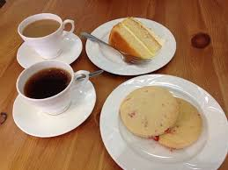
Our Fellowship Continues apart
If you are available, please feel free to remain online to chat.

