Slide 1
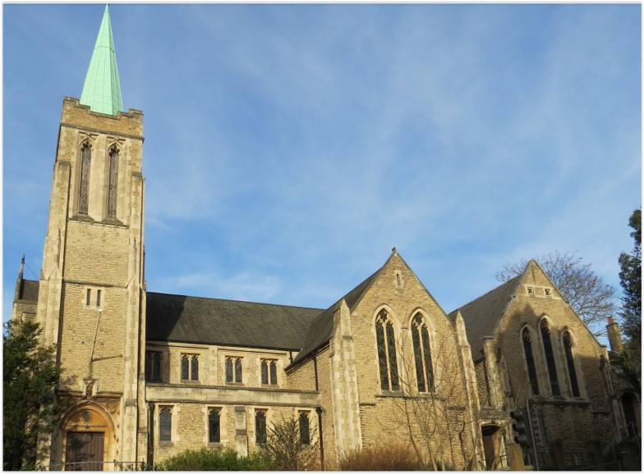
Entry of the Bible. Welcome and notices
Introit. Call to worship
Hymn 353 There’s a wideness in God’s mercy
Prayers of approach
Introduction
Hymn 474 Brother, sister, let me serve you
Reading Revelation 21: 1-6
Choir: Anthem
Reading John 13: 31-35
Sermon
Hymn 349 I heard the voice of Jesus say
Prayers of Intercession. Blessing the Offertory. Lord’s Prayer
Hymn 663 Love divine (tune 2)
Sacrament of Holy Communion
Hymn 191 Songs of thankfulness and praise
Blessing and Sung Amen
Readings: NRSV
All hymns are from Rejoice and Sing. CCLI 1239051
St Andrew’s URC Frognal
18 May 2025 11:00am
Leader: Rev Claire Wilson
Organ prelude
Was der Ferge erzählt (The Ferryman's Story):
Sigfrid Karg-Elert. 1914

Slide 2
Entry of the Bible
Welcome and Notices
Introit
Opening words

Slide 3
Hymn 353 There’s a wideness in God’s mercy
¹ There's a wideness in God’s mercy
like the wideness of the sea;
there's a kindness in his justice
which is more than liberty.
² There is plentiful redemption
through the blood that has been shed;
there is joy for all the members
in the sorrows of the Head.

Slide 4
³ There is grace enough for thousands
of new worlds as great as this;
there is room for fresh creations
in that upper home of bliss.
⁴ For the love of God is broader
than the measure of our mind,
and the heart of the Eternal
is most wonderfully kind.

Slide 5
⁵ But we make his love too narrow
by false limits of our own;
and we magnify his strictness
with a zeal he would not own.
⁶ If our love were but more simple,
we should take him at his word;
and our lives would be illumined
by the of the Lord.

Slide 6
Prayers of approach
Introduction

Slide 7
Hymn 474 Brother, sister, let me serve you
¹ Brother, sister, let me serve you,
let me be as Christ to you;
pray that I may have the grace to
let you be my servant too.
² We are pilgrims on a journey,
and companions on the road;
we are here to help each other
walk the mile and bear the load.

Slide 8
³ I will hold the Christ-light for you
in the night time of your fear;
I will hold my hand out to you,
speak the peace you long to hear.
⁴ I will weep when you are weeping;
I will share your joy and sorrow
when you laugh, I’ll laugh with you;
till we’ve seen the journey through

Slide 9
⁵ When we sing to God in heaven
we shall find such harmony,
born of all we’ve known together
of Christ’s love and agony.
⁶ Brother, sister, let me serve you,
let me as Christ to you;
pray that I may have the grace to
let you be my servant too.

Slide 10
Revelation 21: 1-6
The New Heaven and the New Earth
¹ Then I saw a new heaven and a new earth; for the first heaven and the first earth had passed away, and the sea was no more. ² And I saw the holy city, the new Jerusalem, coming down out of heaven from God, prepared as a bride adorned for her husband. ³ And I heard a loud voice from the throne saying,

Slide 11
‘See, the home of God is among mortals.
He will dwell with them;
they will be his peoples,
and God himself will be with them;
⁴ he will wipe every tear from their eyes.
Death will be no more;
mourning and crying and pain will be no more,
for the first things have passed away.’

Slide 12
⁵ And the one who was seated on the throne said, ‘See, I am making all things new.’ Also he said, ‘Write this, for these words are trustworthy and true.’ ⁶ Then he said to me, ‘It is done! I am the Alpha and the Omega, the beginning and the end. To the thirsty I will give water as a gift from the spring of the water of life.

Slide 13
Choir Anthem

Slide 14
John 13: 31-35
The New Commandment
³¹ When he had gone out, Jesus said, ‘Now the Son of Man has been glorified, and God has been glorified in him. ³² If God has been glorified in him, God will also glorify him in himself and will glorify him at once. ³³ Little children, I am with you only a little longer. You will look for me; and as I said to the Jews so now I say to you, “Where I am going, you cannot come.”

Slide 15
³⁴ I give you a new commandment, that you love one another. Just as I have loved you, you also should love one another. ³⁵ By this everyone will know that you are my disciples, if you have love for one another.’

Slide 16
Sermon

Slide 17
Hymn 349 I heard the voice of Jesus say
¹ I heard the voice of Jesus say,
“Come unto Me and rest;
Lay down, thou weary one, lay down
Thy head upon My breast.”
I came to Jesus as I was,
Weary and worn and sad;
I found in Him a resting place,
And He has made me glad

Slide 18
² I heard the voice of Jesus say,
“Behold, I freely give the living water;
thirsty one,
Stoop down, and drink, and live.”
I came to Jesus, and I drank of that life-giving stream;
My thirst was quenched, my soul revived,
And now I live in Him.

Slide 19
³ I heard the voice of Jesus say,
“I am this dark world’s Light; look unto Me, thy morn shall rise,
And all thy day be bright.”
I looked to Jesus, and I found in Him my Star, my Sun;
And in that light of life I’ll walk,
Till travelling days are done.

Slide 20
Prayers of Intercession
Blessing the Offertory
Lord’s Prayer

Slide 21
Hymn 663 Love divine
¹ Love divine, all loves excelling,
joy of heaven, to earth come down,
fix in us thy humble dwelling,
all thy faithful mercies crown.
Jesus, thou art all compassion,
pure, unbounded love thou art.
Visit us with thy salvation;
enter every trembling heart.

Slide 22
² Come, Almighty, to deliver,
let us all thy life receive.
Suddenly return, and never,
nevermore they temples leave.
Thee we would be always blessing,
serve thee as thy hosts above,
pray, and praise thee without ceasing,
glory in thy perfect love.

Slide 23
³ Finish, then, thy new creation;
true and spotless let us be.
Let us see thy great salvation
perfectly restored in thee.
Changed from glory into glory,
till in heaven we take our place,
till we cast our crowns before thee,
lost in wonder, love and praise.

Slide 24
Sacrament of Holy Communion

Slide 25
Hymn 191 Songs of thankfulness and praise
¹ Songs of thankfulness and praise,
Jesus, Lord, to you we raise,
manifested by the star
to the Magi from afar,
branch of royal David's stem,
in your birth at Bethlehem.
Praise to you, the ever-blest
God in flesh made manifest.

Slide 26
² Manifest at Jordan's stream,
Prophet, Priest, and King supreme,
and at Cana, wedding guest,
in your Godhead manifest;
manifest in power divine,
changing water into wine.
Praise to you, the ever-blest
God in flesh made manifest.

Slide 27
³ Manifest in making whole
Failing limbs and fainting soul;
manifest in healing pain,
Ending Satan’s bitter reign;
manifest in gracious will,
ever bringing good from ill:
Praise to you, the ever-blest
God in flesh made manifest.

Slide 28
⁴ Grant us grace to see you, Lord,
mirrored in your holy word.
May we seek to know your will
All your purposes fulfil
Then, transformed, your glory see
At your great Epiphany
When you are by all confessed
God in flesh made manifest.

Slide 29
Blessing.
Sung Amen.
Organ postlude
Canon No 3: Wilfried Lingenberg.1998
If you are available, please feel free to remain online to chat for fellowship.

Slide 30
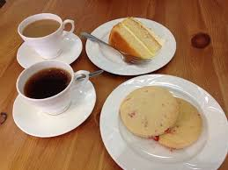
Our Fellowship Continues apart
If you are available, please feel free to remain online to chat.
Organ postlude
Canon No 3: Wilfried Lingenberg.1998

