Slide 1

Entry of the Bible. Welcome and notices
Introit. Call to worship.
Hymn 167 Guide me, O Thou great Jehovah
Prayers of Approach and Confession
Sing The Lord’s Prayer (tune: Joseph Lee)
Reading: Psalm 49 NRSV (Donald Macleod)
All Age Address
Hymn Psalm 49 Wisdom for Riches Treasures for Life Beyond (New hymn composed by Dr David Wong)
Reading: Luke 12:13-21 NRSV (John Robson)
Anthem Hymn Goodness of God
Sermon
Hymn 251 I the Lord of Sea and Sky
Prayers of Intercession (Jean Macleod)
Offertory & Prayer of Dedication
Hymn 153 Great is thy Faithfulness
The Blessing (Sing “May the Grace” (with adapted BSL) to the tune composed by David & Phebe)
Readings: NRSV
All hymns are from “Hymns of Glory Songs of Praise”. CCLI 1239051
St Andrew’s URC Frognal
19 July 2026 11:00am
Leader: Dr Phebe Mann

Slide 2
Entry of the Bible
Welcome and Notices
Introit – Hymn 561 “Blessed Assurance”

Slide 3
Call to worship
Come and seek wisdom together,
you that are low and high, rich and poor.
We come from East and West, North and South,
to encounter the Living God.

Slide 4
Come, let our mouths speak wisdom;
may the meditations of our hearts lead to understanding.
We come to hear the Wisdom of the Ages,
made known to us in Jesus Christ.

Slide 5
Those who trust in their wealth
and boast of the abundance of their riches surround us.
But we trust in the Holy Spirit, our guide and goal,
who teaches us to share our resources with the poor and needy. Amen.

Slide 6
Hymn 345 / 167 Guide me, O Thou great Jehovah,
¹ Guide me, O Thou great Jehovah,
Pilgrim through this barren land.
I am weak, but Thou art mighty;
Hold me with Thy powerful hand.
Bread of heaven,
Feed me now and evermore;
Bread of heaven,
Feed me now and evermore.

Slide 7
² Open now the crystal fountain,
Whence the healing waters flow;
Let the fire and cloudy pillar
Lead me all my journey through.
Strong Deliverer,
Be Thou still my Strength and Shield.
Strong Deliverer,
Be Thou still my Strength and Shield.

Slide 8
³ When I tread the verge of Jordan,
Bid my anxious fears subside;
Death of death, and hell's destruction,
Land me safe on Canaan's side.
Songs of praises,
I will ever give to Thee;
Songs of praises,
I will ever give to Thee.

Slide 9
Prayers of Approach and Confession

Slide 10
The Lord’s Prayer (tune Joseph Lees)
Our Father, which art in heaven, hallowéd be thy name.
Thy kingdom come,
thy will be done in earth as it is in heaven.
Give us this day our daily bread,
and forgive us our trespasses,
as we forgive them who trespass against us.
And lead us not into temptation but deliver us from evil:
for Thine is the kingdom, the power, and the glory,
forever and ever, Amen. Amen.

Slide 11
Psalm 49 (NRSV)
The Folly of Trust in Riches
To the leader. Of the Korahites. A Psalm.
1 Hear this, all you peoples;
give ear, all inhabitants of the world,
2 both low and high,
rich and poor together.
3 My mouth shall speak wisdom;
the meditation of my heart shall be understanding.
4 I will incline my ear to a proverb;
I will solve my riddle to the music of the harp.

Slide 12
5 Why should I fear in times of trouble,
when the iniquity of my persecutors surrounds me,
6 those who trust in their wealth
and boast of the abundance of their riches?
7 Truly, no ransom avails for one’s life,
there is no price one can give to God for it.
8 For the ransom of life is costly,
and can never suffice,
9 that one should live on for ever
and never see the grave.
10 When we look at the wise, they die;
fool and dolt perish together
and leave their wealth to others.

Slide 13
11 Their graves are their homes for ever,
their dwelling-places to all generations,
though they named lands their own.
12 Mortals cannot abide in their pomp;
they are like the animals that perish.
13 Such is the fate of the foolhardy,
the end of those who are pleased with their lot. Selah
14 Like sheep they are appointed for Sheol;
Death shall be their shepherd;
straight to the grave they descend,
and their form shall waste away;
Sheol shall be their home.

Slide 14
15 But God will ransom my soul from the power of Sheol,
for he will receive me. Selah
16 Do not be afraid when some become rich,
when the wealth of their houses increases.
17 For when they die they will carry nothing away;
their wealth will not go down after them.
18 Though in their lifetime they count themselves happy
- for you are praised when you do well for yourself -
19 theywill go to the company of their ancestors,
who will never again see the light.
20 Mortals cannot abide in their pomp;
they are like the animals that perish.

Slide 15
Introduction

Slide 16

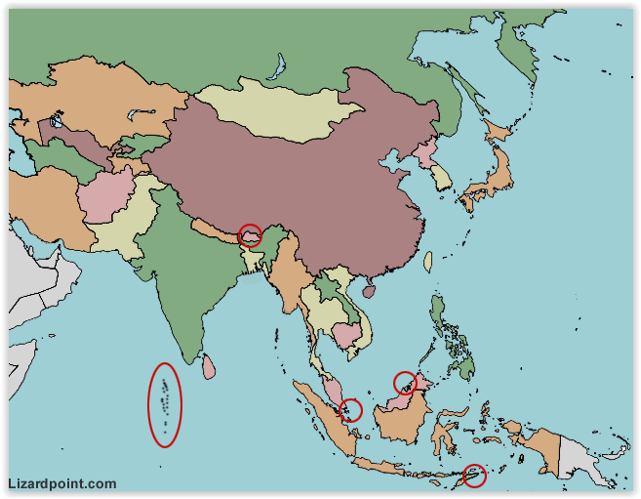

Slide 2

Slide 17
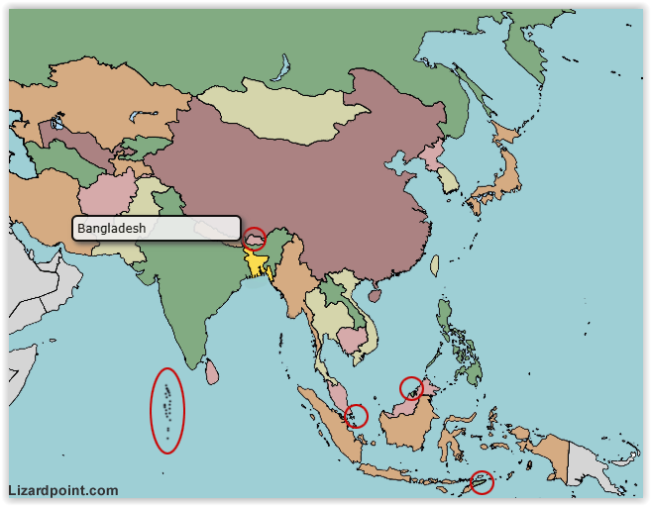
Slide 3

Slide 18
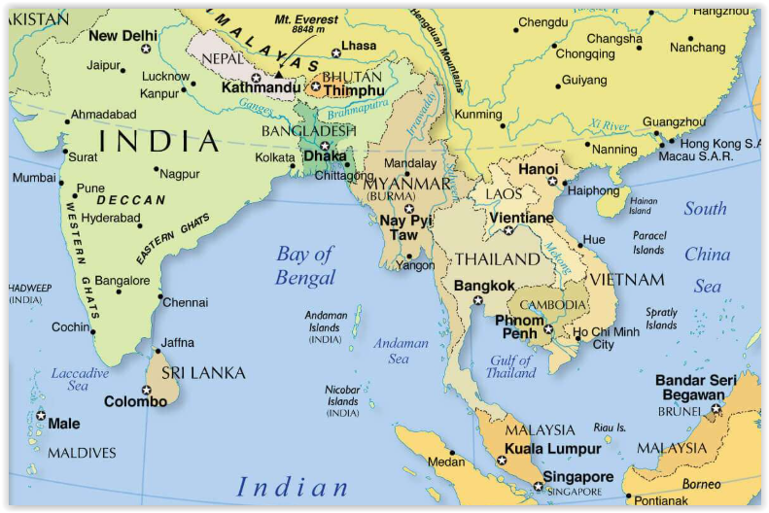
Slide 4

Slide 19

Christian Aid
since 1972
support resilient livelihoods
climate change adaptation
disaster risk reduction
gender equality
Dalit communities
Slide 5

Slide 20

WASH
Water
Sanitation
Hygiene
Slide 6

Slide 21
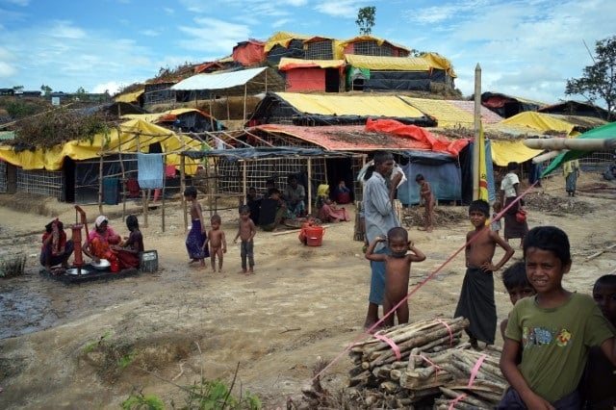
Slide 7
Image credit: Mahmud Hossain Opu

Slide 22
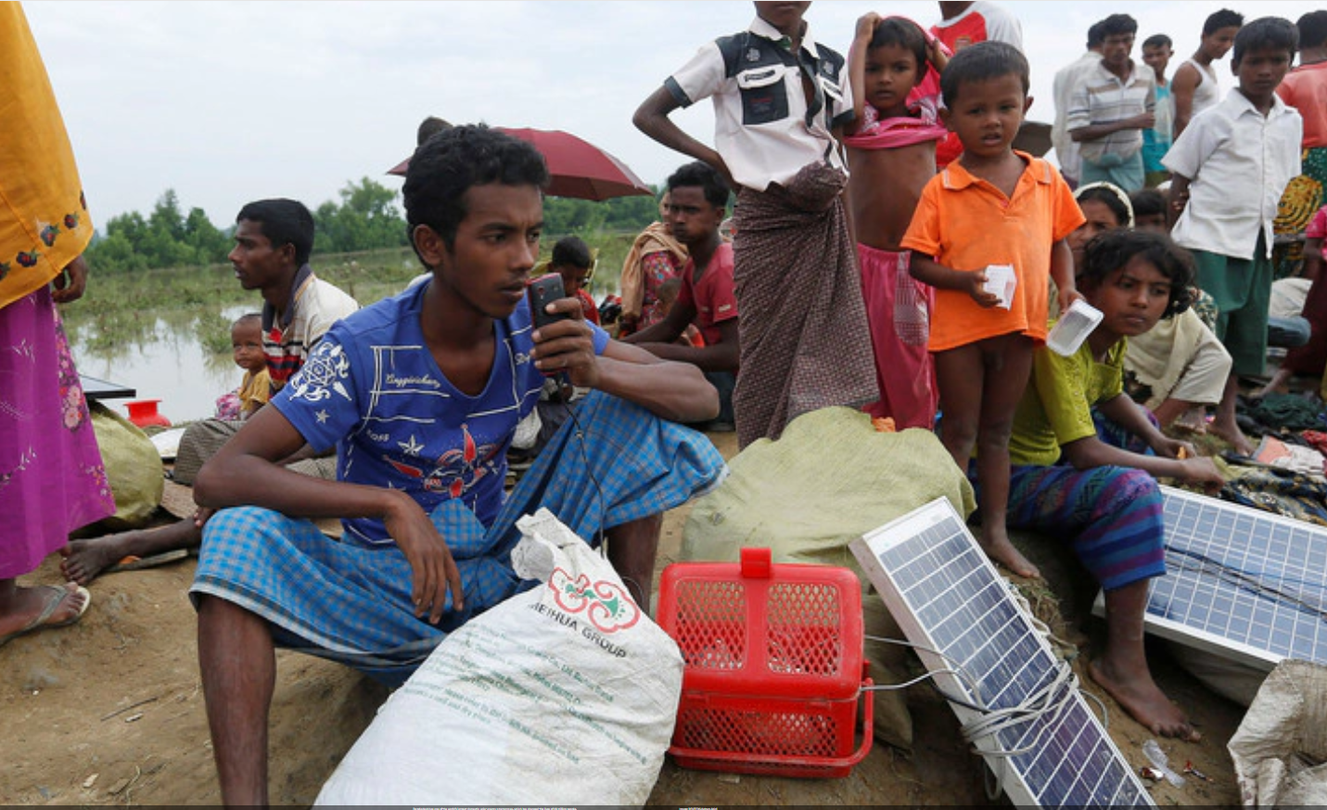
Slide 8
Bangladesh has one of the world’s largest domestic solar energy programmes, which has changed the lives of 20 million people.

Slide 23

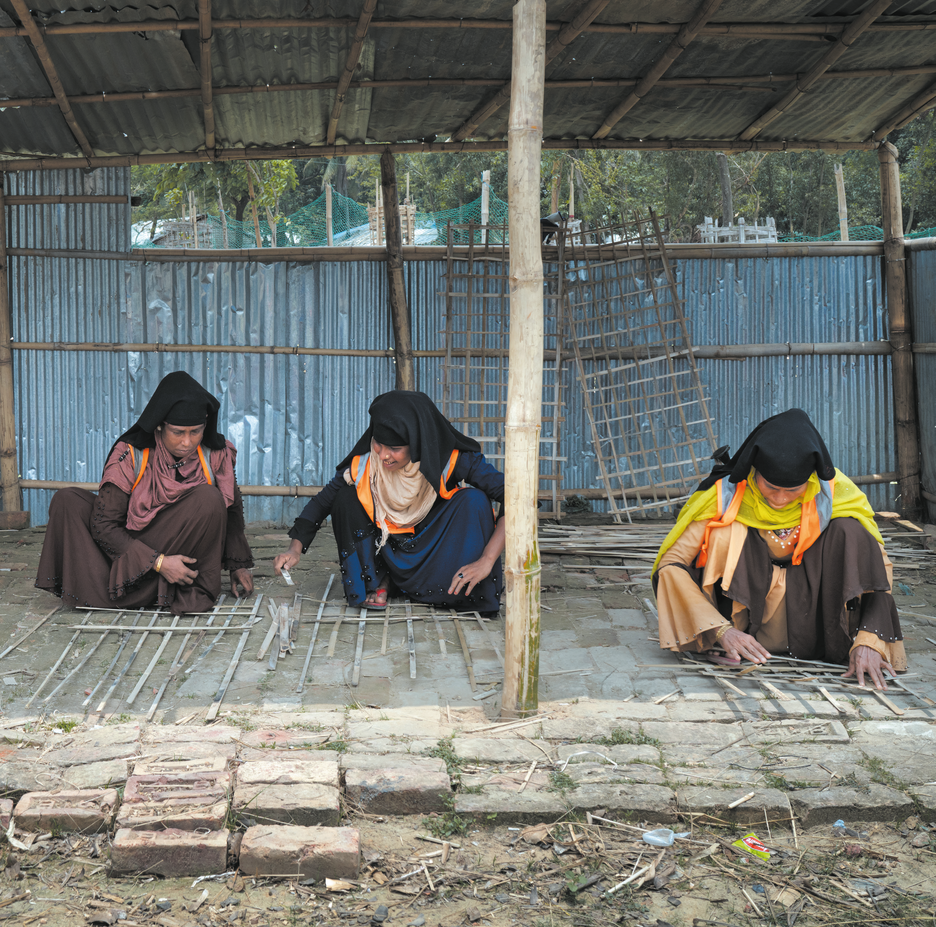
Slide 9

Slide 24

Slide 10

Slide 25
Brew it Fair
Highlighting Injustice
Fair Wages
Safe Conditions Consumer Power
Fair Prices
Community Investment
Slide 11

Slide 26

Slide 12

Slide 27
Christian Aid
Direct Support
Advocacy
Partnering for Change
Interconnectedness
Ethical Choices Matter Advocacy and Awareness
Slide 13

Slide 28

Slide 14

Slide 29


https://urc.org.uk/your-church/church-local-and-global/commitment-for-life/
Slide 15

Slide 30
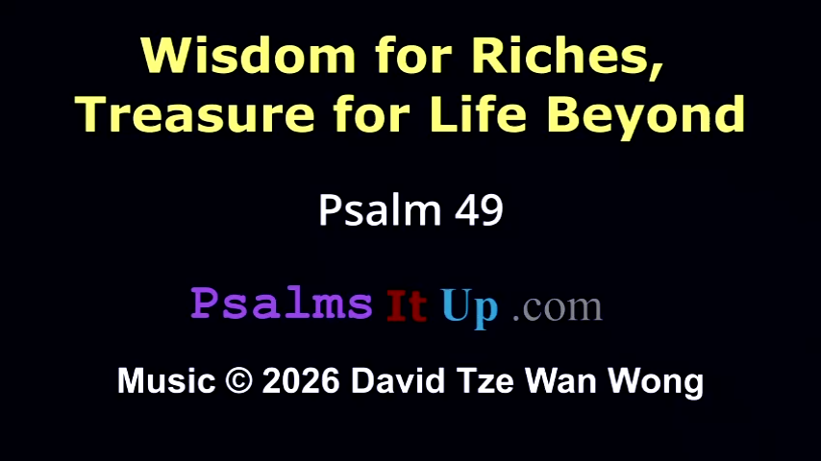

Slide 31
Luke 12: 13-21
The Parable of the Rich Fool
¹³ Someone in the crowd said to him, ‘Teacher, tell my brother to divide the family inheritance with me.’ ¹⁴ But he said to him, ‘Friend, who set me to be a judge or arbitrator over you?’ ¹⁵ And he said to them, ‘Take care! Be on your guard against all kinds of greed; for one’s life does not consist in the abundance of possessions.’ ¹⁶ Then he told them a parable: ‘The land of a rich man produced abundantly.

Slide 32
¹⁷ And he thought to himself, “What should I do, for I have no place to store my crops?” ¹⁸ Then he said, “I will do this: I will pull down my barns and build larger ones, and there I will store all my grain and my goods. ¹⁹ And I will say to my soul, Soul, you have ample goods laid up for many years; relax, eat, drink, be merry.” ²⁰ But God said to him, “You fool! This very night your life is being demanded of you. And the things you have prepared, whose will they be?” ²¹ So it is with those who store up treasures for themselves but are not rich towards God.’

Slide 33
Goodness of God in Bengali - https://www.youtube.com/watch?v=V7E4r1EJLKs
And all my life You have been faithful
ধূয়াঃ সারা-জীবনই তুমি বিশস্ত
And all my life You have been so, so good
সারা-জীবনই তুমি সদা মঙ্গলময়
With every breath that I am able
প্রতিটি নিঃশ্বাস দিয়ে আমি
I will sing of the goodness of God
গেয়ে যাব তোমার দয়ার গুনগান

Slide 34
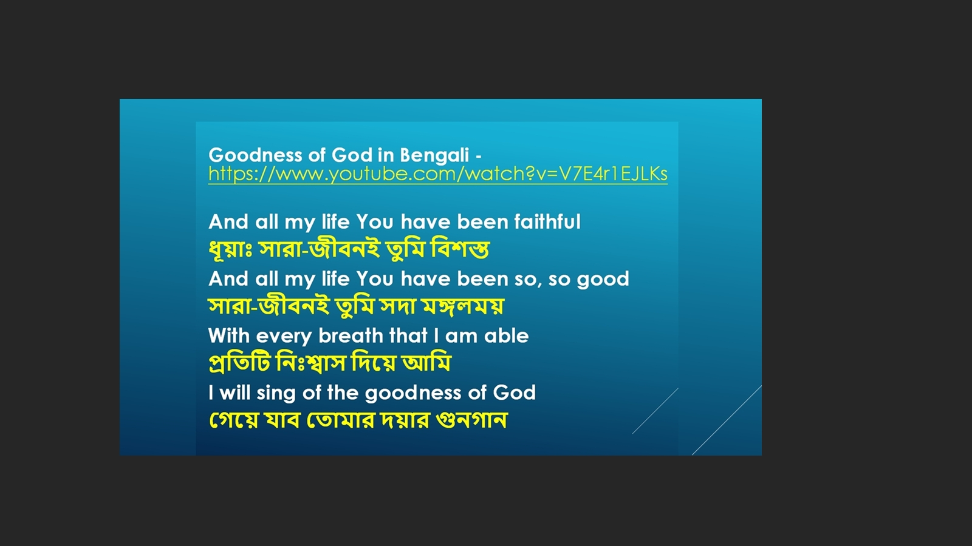

Slide 35
Anthem Hymn Goodness of God
And all my life You have been faithful
And all my life You have been so, so good
With every breath that I am able
Oh, I will sing of the goodness of God

Slide 36
¹ I love You, Lord, For Your mercy never fails me
All my days, I've been held in Your hands
From the moment that I wake up
Until I lay my head
Oh, I will sing of the goodness of God

Slide 37
And all my life You have
been faithful
And all my life You have
been so, so good
With every breath that I am able
Oh, I will sing of the goodness of God
(twice)

Slide 38
² I love Your voice, You have led me
through the fire
And in darkest night You are close
like no other
I've known You as a Father
I've known You as a Friend
And I have lived in the
goodness of God,

Slide 39
And all my life You have
been faithful
And all my life You have
been so, so good
With every breath that I am able
Oh, I will sing of the goodness of God
(twice)

Slide 40
Your goodness is running after,
It’s running after me
Your goodness is running after,
It’s running after me
With my life laid down,
I surrender now,
I give You everything

Slide 41
And all my life You have
been faithful
And all my life You have
been so, so good
With every breath that I am able
Oh, I will sing of the goodness of God
(twice)

Slide 42
Sermon

Slide 43
Hymn 251 I, the Lord of sea and sky
¹ I, the Lord of sea and sky,
I have heard My people cry.
All who dwell in dark and sin,
My hand will save.
I who made the stars of night,
I will make their darkness bright.
Who will bear My light to them?
Whom shall I send?

Slide 44
Chorus
Here I am Lord, Is it I, Lord?
I have heard You calling in the night.
I will go Lord, if You lead me.
I will hold Your people in my heart.

Slide 45
² I, the Lord of snow and rain,
I have borne my people's pain.
I have wept for love of them,
they turn away.
I will break their hearts of stone,
Give them hearts for love alone.
I will speak My word to them
Whom shall I send?

Slide 46
Chorus
Here I am Lord, Is it I, Lord?
I have heard You calling in the night.
I will go Lord, if You lead me.
I will hold Your people in my heart.

Slide 47
³ I, the Lord of wind and flame
I will tend the poor and lame.
I will set a feast for them,
My hand will save
Finest bread I will provide,
Till their hearts be satisfied.
I will give My life to them,
Whom shall I send?

Slide 48
Chorus
Here I am Lord, Is it I, Lord?
I have heard You calling in the night.
I will go Lord, if You lead me.
I will hold Your people in my heart.

Slide 49
Prayers of Intercession
Offertory & Prayer of Dedication

Slide 50
Hymn 96 / 153 Great is Thy Faithfulness
¹ Great is thy faithfulness, O God my
Father
There is no shadow of turning with
thee.
Thou changest not, thy compassions,
they fail not.
As thou hast been thou forever wilt be.

Slide 51
Refrain:
Great is thy faithfulness!
Great is thy faithfulness!
Morning by morning new mercies I see.
All I have needed thy hand hath provided.
Great is thy faithfulness, Lord, unto me!

Slide 52
² Summer and winter, and
springtime and harvest,
sun, moon, and stars in their
courses above,
join with all nature in manifold witness
to thy great faithfulness, mercy,
and love.

Slide 53
Refrain:
Great is thy faithfulness!
Great is thy faithfulness!
Morning by morning new mercies I see.
All I have needed thy hand hath provided.
Great is thy faithfulness, Lord, unto me!

Slide 54
³ Pardon for sin and a peace
that endureth,
thine own dear presence to cheer
and to guide,
strength for today and bright hope
for tomorrow;
blessings all mine, with
ten thousand beside!

Slide 55
Blessing.
If you are available, please feel free to remain online to chat for fellowship.

Slide 56
May the Grace (including Signing)
Tune: David Wong and Phebe Mann
May the grace
of our Lord Jesus Christ,
the love of God, and the
fellowship of the Holy Spirit
be with us all forevermore.
Amen.
If you are available, please feel free to remain online to chat for fellowship.

Slide 57

Our Fellowship Continues apart
If you are available, please feel free to remain online to chat.

