Slide 1
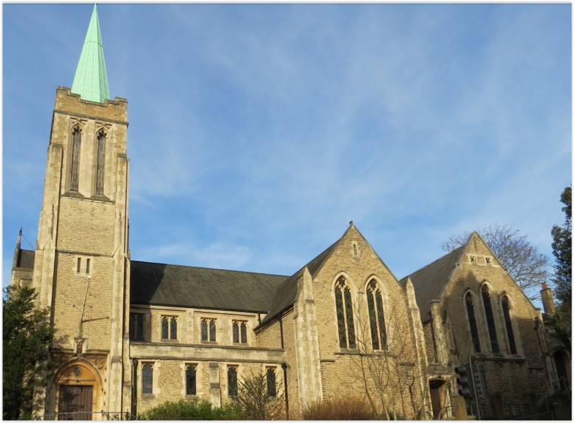
Entry of the Bible. Welcome and notices
Introit. Call to worship.
Hymn 67 Immortal, invisible, God only wise
Prayers of approach and confession
Introduction
Hymn 354 Come, living God when least expected
Reading: Exodus Ch 3 v 1-15
Hymn 707 (Psalm 95)
Reading: Matthew Ch 16 v 21-18
Anthem
Sermon
Prayers of intercession. Blessing of the offerings.
The Lord’s Prayer
Hymn 449 I hunger and I thirst
Sacrament of Holy Communion
Hymn 602 Forth in the peace of Christ we go
Blessing. Sung Amen.
Readings: NRSV
All hymns are from Rejoice and Sing. CCLI 1239051
St Andrew’s URC Frognal
30 August 2026 11:00am
Leader: Andrew Glennie

Slide 2
Entry of the Bible
Welcome and Notices
Introit
Call to worship

Slide 3
Hymn 67 Immortal, invisible, God only wise
¹ Immortal, invisible,
God only wise,
in light inaccessible
hid from our eyes,
most blessed, most glorious,
the Ancient of Days,
almighty, victorious,
thy great name we praise.

Slide 4
² Unresting, unhasting,
and silent as light,
nor wanting, nor wasting,
thou rulest in might;
thy justice like mountains,
high soaring above
thy clouds which are fountains
of goodness and love.

Slide 5
³ To all life thou givest,
to both great and small;
in all life thou livest,
the true life of all;
we blossom and flourish
as leaves on the tree,
and wither and perish –
but naught changeth thee.

Slide 6
⁴ Great Father of glory:
O help us to see
'tis only the splendour
of light hideth thee.
And so let thy glory,
Almighty, impart,
through Christ in the story,
thy Christ to the heart.

Slide 7
Prayers of approach and confession
Introduction

Slide 8
Hymn 354 Come, living God, when least expected
¹ Come, living God, when least expected,
when minds are dull and hearts are cold,
through sharpening word and warm affection
revealing truths as yet untold.

Slide 9
² Break from the tomb in which we hide you
to speak again in startling ways;
break through the words in which we bind you
to resurrect our lifeless praise.
³ Come now, as once you came to Moses
within the bush alive with flame,
or to Elijah on the mountain,
by silence pressing home your claim.

Slide 10
⁴ So, let our minds be sharp to read you
in sight or sound or printed page,
and let us greet you in our neighbours,
in ardent youth or mellow age.
⁵ Then, through our gloom, your Son will meet us
as vivid truth and living Lord,
exploding doubt and disillusion
to scatter hope and joy abroad.

Slide 11
⁶ Then we will share his radiant brightness
and, blazing through the dread of night,
illuminate by love and reason,
for those in darkness, faith's delight.

Slide 12
Exodus 3:1-15
Moses at the Burning Bush
¹ Moses was keeping the flock of his father-in-law Jethro, the priest of Midian; he led his flock beyond the wilderness, and came to Horeb, the mountain of God. ² There the angel of the Lord appeared to him in a flame of fire out of a bush; he looked, and the bush was blazing, yet it was not consumed. ³ Then Moses said, ‘I must turn aside and look at this great sight, and see why the bush is not burned up.’

Slide 13
⁴ When the Lord saw that he had turned aside to see, God called to him out of the bush, ‘Moses, Moses!’ And he said, ‘Here I am.’ ⁵ Then he said, ‘Come no closer! Remove the sandals from your feet, for the place on which you are standing is holy ground.’ ⁶ He said further, ‘I am the God of your father, the God of Abraham, the God of Isaac, and the God of Jacob.’ And Moses hid his face, for he was afraid to look at God.

Slide 14
⁷ Then the Lord said, ‘I have observed the misery of my people who are in Egypt; I have heard their cry on account of their taskmasters. Indeed, I know their sufferings, ⁸ and I have come down to deliver them from the Egyptians, and to bring them up out of that land to a good and broad land, a land flowing with milk and honey, to the country of the Canaanites, the Hittites, the Amorites, the Perizzites, the Hivites, and the Jebusites. ⁹ The cry of the Israelites has now come to me; I have also seen how the Egyptians oppress them. ¹⁰ So come, I will send you to Pharaoh to bring my people, the Israelites, out of Egypt.’

Slide 15
¹¹ But Moses said to God, ‘Who am I that I should go to Pharaoh, and bring the Israelites out of Egypt?’ ¹² He said, ‘I will be with you; and this shall be the sign for you that it is I who sent you: when you have brought the people out of Egypt, you shall worship God on this mountain.’
The Divine Name Revealed
¹³ But Moses said to God, ‘If I come to the Israelites and say to them, “The God of your ancestors has sent me to you”, and they ask me, “What is his name?” what shall I say to them?’

Slide 16
¹⁴ God said to Moses, ‘I am who I am.’ He said further, ‘Thus you shall say to the Israelites, “I am has sent me to you.”’ ¹⁵ God also said to Moses, ‘Thus you shall say to the Israelites, “The Lord, the God of your ancestors, the God of Abraham, the God of Isaac, and the God of Jacob, has sent me to you”:
This is my name for ever,
and this my title for all generations.

Slide 17
Psalms 95 Hymn 707
¹ O come, and let us to the Lord
In songs our voices raise,
With joyful noise let us the Rock
Of our salvation praise.
² Let us before his presence come
With praise and thankful voice;
Let us sing psalms to him with grace,
And make a joyful noise.

Slide 18
³ The Lord's a great God, and great King
Above all gods he is;
Depths of the earth are in his hand,
The strength of hills is his.
⁴ To him the spacious sea belongs,
For he the same did make;
The dry land also from his hands
Its form at first did take.

Slide 19
⁵ O come and let us worship him,
Let us bow down withal,
And on our knees before the Lord
Our Maker let us fall.

Slide 20
Matthew 16:21-18
Jesus Foretells His Death and Resurrection
²¹ From that time on, Jesus began to show his disciples that he must go to Jerusalem and undergo great suffering at the hands of the elders and chief priests and scribes, and be killed, and on the third day be raised. ²² And Peter took him aside and began to rebuke him, saying, ‘God forbid it, Lord! This must never happen to you.’

Slide 21
²³ But he turned and said to Peter, ‘Get behind me, Satan! You are a stumbling-block to me; for you are setting your mind not on divine things but on human things.’
The Cross and Self-Denial
²⁴ Then Jesus told his disciples, ‘If any want to become my followers, let them deny themselves and take up their cross and follow me. ²⁵ For those who want to save their life will lose it, and those who lose their life for my sake will find it.

Slide 22
²⁶ For what will it profit them if they gain the whole world but forfeit their life? Or what will they give in return for their life?
²⁷ ‘For the Son of Man is to come with his angels in the glory of his Father, and then he will repay everyone for what has been done. ²⁸ Truly I tell you, there are some standing here who will not taste death before they see the Son of Man coming in his kingdom.’

Slide 23
Anthem
Sermon
Prayers of intercession
Blessing of the offerings
The Lord’s Prayer

Slide 24
Hymn 449 I hunger and I thirst
¹ I hunger and I thirst:
Jesu, my manna be;
ye living waters, burst
out of the rock for me.

Slide 25
² Thou bruised and broken Bread,
my life-long wants supply;
as living souls are fed,
O feed me, or I die.
³ Thou true life-giving Vine,
let me thy sweetness prove;
renew my life with thine,
refresh my soul with love.

Slide 26
⁴ Rough paths my feet have trod
since first their course began:
feed me, thou Bread of God;
help me, thou Son of Man.
⁵ For still the desert lies
my thirsting soul before:
O living waters, rise
within me evermore.

Slide 27
Sacrament of Holy Communion

Slide 28
Hymn 602 Forth in the peace of Christ we go
¹ Forth in the peace of Christ we go;
Christ to the world with joy we bring;
Christ in our minds, Christ in our lips,
Christ in our hearts, the world's true King.

Slide 29
² King of our hearts, Christ makes us kings;
kingship with Him His servants gain;
with Christ, the Servant-Lord of all,
Christ's world we serve to share Christ's reign.
³ Priests of the world, Christ sends us forth
this world of time to consecrate,
our world of sin by grace to heal,
Christ's world in Christ to recreate.

Slide 30
⁴ Prophets of Christ, we hear His word:
He claims our minds, to search His ways,
He claims our lips, to speak His truth,
He claims our hearts, to sing His praise.
⁵ We are his Church; He makes us one:
here is one hearth for all to find,
here is one flock, one Shepherd-King,
here is one faith, one heart, one mind.

Slide 31
Blessing.
Sung Amen.
If you are available, please feel free to remain online to chat for fellowship.

Slide 32
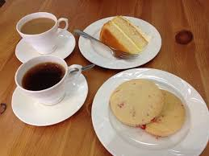
Our Fellowship Continues apart
If you are available, please feel free to remain online to chat.

