Slide 1
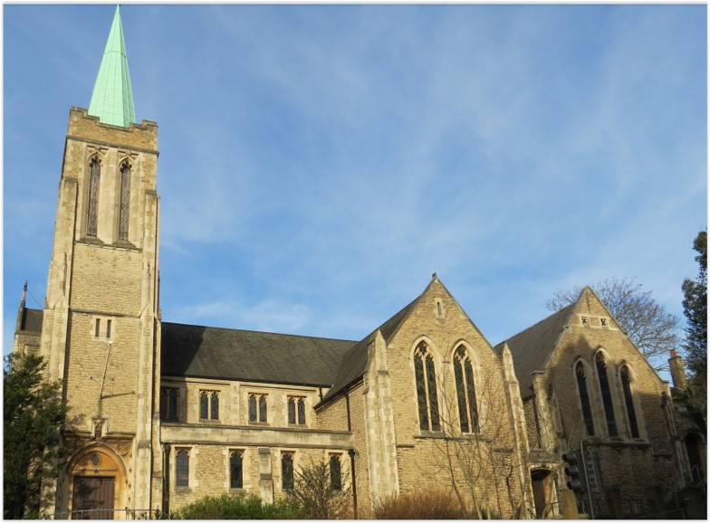
Entry of the Bible. Welcome and notices
Introit. Call to worship
Hymn 285 O for a thousand tongues to sing
Prayers of Approach & Confession
Introduction to today’s theme
Hymn 495 Father, hear the prayer we offer
Reading from St Matthew 14:22 – 32
Choir Anthem
Reading from 1 Kings 19:1– 18
Hymn 499 Have faith in God, my heart
Sermon
Hymn 96 Great is thy faithfulness
Prayers of Thanksgiving and Intercession, Blessing the offering and the Lord’s Prayer
Hymn 261 At the name of Jesus
Blessing and Sung Amen
Readings: NRSV. All hymns are from
Hymns of Glory, Songs of Praise. CCLI 1239051
St Andrew’s URC Frognal
16 August 2026 11:00am
Leader: Christy Sawyer

Slide 2
Entry of the Bible
Welcome and Notices
Introit
Call to Worship

Slide 3
Hymn 285 O for a thousand tongues to sing
¹ O for a thousand tongues to sing
my great Redeemer's praise,
the glories of my God and King,
the triumphs of his grace.
² Jesus, the name that charms our fears,
that bids our sorrows cease;
'tis music in the sinner's ears,
'tis life and health and peace.

Slide 4
³ He breaks the power of cancelled sin,
he sets the prisoner free;
his blood can make the foulest clean,
his blood availed for me.
⁴ He speaks, and listening to his voice
new life the dead receive;
the mournful, broken hearts rejoice,
the humble poor believe.

Slide 5
⁵ Hear him, ye deaf; his praise, ye dumb,
your loosened tongues employ;
ye blind, behold your Saviour come;
and leap, ye lame, for joy!
⁶ My gracious Master and my God,
assist me to proclaim,
to spread through all the earth abroad
the honours of thy name.

Slide 6
Prayers of Approach & Confession
Introduction to today’s theme

Slide 7
Hymn Father, hear the prayer we offer
¹ Father, hear the prayer we offer:
not for ease that prayer shall be,
but for strength that we may ever
live our lives courageously.
² Not for ever in green pastures
do we ask our way to be;
but the steep and rugged pathway
may we tread rejoicingly.

Slide 8
³ Not for ever by still waters
would we idly rest and stay;
but would smite the living fountains
from the rocks along our way.
⁴ Be our strength in hours of weakness,
in our wanderings be our guide;
through endeavour, failure, danger,
Father, be thou at our side.

Slide 9
Matthew 14: 22-32
Jesus Walks on the Water
²² Immediately he made the disciples get into a boat and go on ahead to the other side, while he dismissed the crowds. ²³ And after he had dismissed the crowds, he went up the mountain by himself to pray. When evening came, he was there alone, ²⁴ but by this time the boat, battered by the waves, was far from the land,[a] for the wind was against them. ²⁵ And early in the morning he came walking toward them on the sea.

Slide 10
²⁶ But when the disciples saw him walking on the sea, they were terrified, saying, “It is a ghost!” And they cried out in fear. ²⁷ But immediately Jesus spoke to them and said, “Take heart, it is I; do not be afraid.”
²⁸ Peter answered him, “Lord, if it is you, command me to come to you on the water.” ²⁹ He said, “Come.” So Peter got out of the boat, started walking on the water, and came toward Jesus.

Slide 11
³⁰ But when he noticed the strong wind,[b] he became frightened, and, beginning to sink, he cried out, “Lord, save me!” ³¹ Jesus immediately reached out his hand and caught him, saying to him, “You of little faith, why did you doubt?” ³² When they got into the boat, the wind ceased.

Slide 12
Choir Anthem

Slide 13
1 Kings 19:1-18
¹ Ahab told Jezebel all that Elijah had done, and how he had killed all the prophets with the sword. ² Then Jezebel sent a messenger to Elijah, saying, ‘So may the gods do to me, and more also, if I do not make your life like the life of one of them by this time tomorrow.’ ³ Then he was afraid; he got up and fled for his life, and came to Beer-sheba, which belongs to Judah; he left his servant there.

Slide 14
⁴ But he himself went a day’s journey into the wilderness, and came and sat down under a solitary broom tree. He asked that he might die: ‘It is enough; now, O Lord, take away my life, for I am no better than my ancestors.’ ⁵ Then he lay down under the broom tree and fell asleep. Suddenly an angel touched him and said to him, ‘Get up and eat.’ ⁶ He looked, and there at his head was a cake baked on hot stones, and a jar of water. He ate and drank, and lay down again. ⁷ The angel of the Lord came a second time, touched him, and said, ‘Get up and eat, otherwise the journey will be too much for you.’

Slide 15
⁸ He got up, and ate and drank; then he went in the strength of that food for forty days and forty nights to Horeb the mount of God. ⁹ At that place he came to a cave, and spent the night there.
Then the word of the Lord came to him, saying, ‘What are you doing here, Elijah?’ ¹⁰ He answered, ‘I have been very zealous for the Lord, the God of hosts; for the Israelites have forsaken your covenant, thrown down your altars, and killed your prophets with the sword. I alone am left, and they are seeking my life, to take it away.’

Slide 16
Elijah Meets God at Horeb
¹¹ He said, ‘Go out and stand on the mountain before the Lord, for the Lord is about to pass by.’ Now there was a great wind, so strong that it was splitting mountains and breaking rocks in pieces before the Lord, but the Lord was not in the wind; and after the wind an earthquake, but the Lord was not in the earthquake; ¹² and after the earthquake a fire, but the Lord was not in the fire; and after the fire a sound of sheer silence. ¹³ When Elijah heard it, he wrapped his face in his mantle and went out and stood at the entrance of the cave.

Slide 17
Then there came a voice to him that said, ‘What are you doing here, Elijah?’ ¹⁴ He answered, ‘I have been very zealous for the Lord, the God of hosts; for the Israelites have forsaken your covenant, thrown down your altars, and killed your prophets with the sword. I alone am left, and they are seeking my life, to take it away.’ ¹⁵ Then the LORD said to him, ‘Go, return on your way to the wilderness of Damascus; when you arrive, you shall anoint Hazael as king over Aram.

Slide 18
¹⁶ Also you shall anoint Jehu son of Nimshi as king over Israel; and you shall anoint Elisha son of Shaphat of Abel-meholah as prophet in your place. ¹⁷ Whoever escapes from the sword of Hazael, Jehu shall kill; and whoever escapes from the sword of Jehu, Elisha shall kill. ¹⁸ Yet I will leave seven thousand in Israel, all the knees that have not bowed to Baal, and every mouth that has not kissed him.’

Slide 19
Hymn 499 Have faith in God, my heart
¹ Have faith in God, my heart
trust and be unafraid;
God will fulfil in every part
each promise he has made.
² Have faith in God, my mind,
although your light burns low;
God’s mercy holds a wiser plan
than you can fully know.

Slide 20
³ Have faith in God, my soul,
his cross for ever stands;
and neither life nor death can tear
his children from his hands.
⁴ Lord Jesus, make me whole;
grant me no resting place
until I rest, heart, mind, and soul,
the captive of your grace.

Slide 21
Sermon

Slide 22
Hymn 96 / 153 Great is Thy Faithfulness
¹ Great is thy faithfulness, O God my
Father
There is no shadow of turning with
thee.
Thou changest not, thy compassions,
they fail not.
As thou hast been thou forever wilt be.

Slide 23
Refrain:
Great is thy faithfulness!
Great is thy faithfulness!
Morning by morning new mercies I see.
All I have needed thy hand hath provided.
Great is thy faithfulness, Lord, unto me!

Slide 24
² Summer and winter, and
springtime and harvest,
sun, moon, and stars in their
courses above,
join with all nature in manifold witness
to thy great faithfulness, mercy,
and love.

Slide 25
Refrain:
Great is thy faithfulness!
Great is thy faithfulness!
Morning by morning new mercies I see.
All I have needed thy hand hath provided.
Great is thy faithfulness, Lord, unto me!

Slide 26
³ Pardon for sin and a peace
that endureth,
thine own dear presence to cheer
and to guide,
strength for today and bright hope
for tomorrow;
blessings all mine, with
ten thousand beside!

Slide 27
Refrain:
Great is thy faithfulness!
Great is thy faithfulness!
Morning by morning new mercies I see.
All I have needed thy hand hath provided.
Great is thy faithfulness, Lord, unto me!

Slide 28
Prayers of Thanksgiving and Intercession,
Blessing the offering
The Lord’s Prayer

Slide 29
Hymn 261 At the name of Jesus
¹ At the name of Jesus every knee shall bow,
every tongue confess him King of glory now.
'Tis the Father's pleasure we should call him Lord,
who from the beginning was the mighty Word.
² Humbled for a season to receive a Name
from the lips of sinners unto whom he came,
he became a witness, faithful to the last,
and returned victorious, when from death he passed.

Slide 30
³ In your hearts enthrone him; there let him make new
all that is not holy, all that is not true.
He is God the Saviour, He is Christ the Lord
ever to be worshipped, trusted and adored
⁴ When the same Lord Jesus shall appear again,
in his Father's glory, there with him to reign;
then may we adore him, all before him bow
as our hearts confess him King of glory now.

Slide 31
Blessing.
Sung Amen.
If you are available, please feel free to remain online to chat for fellowship.

Slide 32
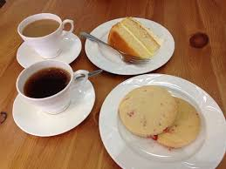
Our Fellowship Continues apart
If you are available, please feel free to remain online to chat.

