Slide 1
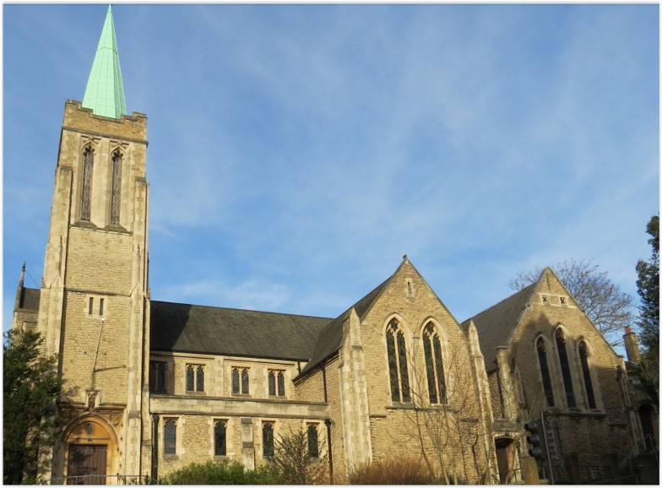
Entry of the Bible. Welcome and notices
Introit. Call to worship
Hymn 571 Christ is the King
Prayers of Approach, confession & assurance of forgiveness
Introduction to today’s theme
Hymn 623 Eternal Ruler of the ceaseless round
Reading: Romans 13: 8-14
Choir Anthem
Reading: Matthew 18: 15-20
Hymn 406 Fill thou my life
Sermon
Hymn 277 (tune 2) How sweet the name of Jesus sounds
Prayers of Thanksgiving and Intercession
Blessing the Offering & the Lord’s Prayer
Hymn 582 Thanks be to God
Blessing. Sung Amen.
Readings: NRSV
All hymns are from Rejoice and Sing. CCLI 1239051
St Andrew’s URC Frognal
6 September 2026 11:00am
Leader: Rev Claire Wilson

Slide 2
Entry of the Bible
Welcome and Notices
Introit
Call to worship

Slide 3
Hymn 571 Christ is the King
¹ Christ is the King! O friends rejoice;
brothers and sisters, with one voice
tell all the earth he is your choice:
Alleluia! Alleluia! Alleluia!
² O magnify the Lord, and raise
anthems of joy and holy praise
for Christ's brave saints of ancient days:
Alleluia! Alleluia! Alleluia!

Slide 4
³ Christ through all ages is the same:
place the same hope in his great name,
with the same faith his word proclaim:
Alleluia! Alleluia! Alleluia!
⁴ Let Love's unconquerable might
your scattered companies unite
in service to the Lord of light: Alleluia!
⁵ So shall God's will on earth be done,
new lamps be lit, new tasks begun,
and the whole Church at last be one: Alleluia!

Slide 5
Prayers of Approach, confession & assurance of forgiveness
Introduction to today’s theme

Slide 6
Hymn 623 Eternal ruler of the ceaseless round
¹ Eternal Ruler of the ceaseless round
of circling planets singing on their way;
guide of the nations from the night profound
into the glory of the perfect day;
rule in our hearts, that we may ever be
guided and strengthened and upheld by thee.

Slide 7
² We are of thee, the children of thy love,
the brothers of thy well-belovèd Son;
descend, O Holy Spirit, like a dove,
into our hearts, that we may be as one:
as one with thee, to whom we ever tend;
as one with him, our Brother and our Friend.

Slide 8
³ We would be one in hatred of all wrong,
one in our love of all things sweet and fair,
one with the joy that breaketh into song,
one with the grief that trembles into prayer,
one in the power that makes thy children free
to follow truth, and thus to follow thee.

Slide 9
⁴ O clothe us with thy heavenly armour, Lord,
thy trusty shield, thy sword of love divine;
our inspiration be thy constant word;
we ask no victories that are not thine:
give or withhold, let pain or pleasure be;
enough to know that we are serving thee.

Slide 10
Romans 13:8-14
Love for One Another
⁸ Owe no one anything, except to love one another; for the one who loves another has fulfilled the law. ⁹ The commandments, ‘You shall not commit adultery; You shall not murder; You shall not steal; You shall not covet’; and any other commandment, are summed up in this word, ‘Love your neighbour as yourself.’ ¹⁰ Love does no wrong to a neighbour; therefore, love is the fulfilling of the law.

Slide 11
An Urgent Appeal
¹¹ Besides this, you know what time it is, how it is now the moment for you to wake from sleep. For salvation is nearer to us now than when we became believers; ¹² the night is far gone, the day is near. Let us then lay aside the works of darkness and put on the armour of light; ¹³ let us live honourably as in the day, not in revelling and drunkenness, not in debauchery and licentiousness, not in quarrelling and jealousy. ¹⁴ Instead, put on the Lord Jesus Christ, and make no provision for the flesh, to gratify its desires.

Slide 12
Choir Anthem

Slide 13
Matthew 18: 15-20
Reproving Another Who Sins
¹⁵ ‘If another member of the church sins against you, go and point out the fault when the two of you are alone. If the member listens to you, you have regained that one. ¹⁶ But if you are not listened to, take one or two others along with you, so that every word may be confirmed by the evidence of two or three witnesses.

Slide 14
¹⁷ If the member refuses to listen to them, tell it to the church; and if the offender refuses to listen even to the church, let such a one be to you as a Gentile and a tax-collector. ¹⁸ Truly I tell you, whatever you bind on earth will be bound in heaven, and whatever you loose on earth will be loosed in heaven. ¹⁹ Again, truly I tell you, if two of you agree on earth about anything you ask, it will be done for you by my Father in heaven. ²⁰ For where two or three are gathered in my name, I am there among them.’

Slide 15
Hymn 406 Fill thou my life
¹ Fill thou my life, O Lord my God,
in every part with praise,
that my whole being may proclaim
thy being and thy ways.
² Not for the lip of praise alone
nor e’en the praising heart
I ask, but for a life made up
of praise in every part:

Slide 16
³ Praise in the common things of life,
its goings out and in;
praise in each duty and each deed,
however small and mean.
⁴ Fill every part of me with praise;
let all my being speak
of thee and of thy love,
O Lord, poor though I be and weak.

Slide 17
⁵ So shalt thou, gracious Lord, from me
receive the glory due;
and so shall I begin on earth
the song for ever new.
⁶ So shall no part of day or night
from sacredness be free;
but all my life, in every step,
be fellowship with thee.

Slide 18
Sermon

Slide 19
Hymn 277 How sweet the name of Jesus sounds
¹ How sweet the name of Jesus sounds
in a believer’s ear:
it soothes his sorrows, heals his wounds,
and drives away our fear.
² It makes the wounded spirit whole
and calms the troubled breast;
‘tis manna to the hungry soul,
and to the weary, rest.

Slide 20
³ Dear Name! the rock on which I build,
my Shield and hiding-place,
my never-failing treasure, filled
with boundless stores of grace:
⁴ Jesus, my Shepherd and my Friend,
my Prophet, Priest, and King;
my Lord, my Life, my Way, my End,
accept the praise I bring.

Slide 21
⁵ Weak is the effort of my heart,
and cold my warmest thought;
but when I see thee as thou art,
I’ll praise thee as I ought.
⁶ Till then I would thy love proclaim
with every fleeting breath,
and may the music of thy Name
refresh my soul in death.

Slide 22
Prayers of Thanksgiving and Intercession
Blessing the Offering & the Lord’s Prayer

Slide 23
Hymn 582 Thanks be to God
¹ Thanks be to God, whose Church on earth
has stood the tests of time and place,
and everywhere proclaims new birth
through Christ whose love reveals God's face.
² Thanks be to God, whose Spirit sent
apostles out upon his way;
from east to west the message went;
on Greek and Roman dawned the day.

Slide 24
³ Thanks be to God, whose later voice
from west to east sent back the word
which, through the servants of his choice,
at last in every tongue was heard.
⁴ Thanks be to God who now would reach
his listeners in more global ways;
now each will send the news, and each
receive and answer it in praise.
⁵ Thanks be to God, in whom we share
today the mission of his Son;
may all his Church that time prepare
when, like the task, the world is one.

Slide 25
Blessing.
Sung Amen.
If you are available, please feel free to remain online to chat for fellowship.

Slide 26
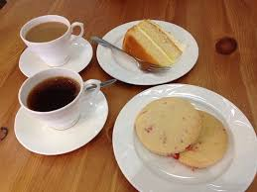
Our Fellowship Continues apart
If you are available, please feel free to remain online to chat.

