Slide 1
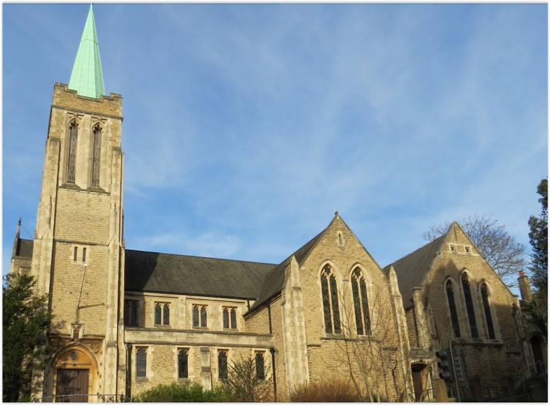
Entry of the Bible. Welcome and notices
Introit. Call to worship.
Hymn 391 Stand up and bless the Lord
Prayers of approach and confession
Introduction
Hymn 560 Glorious things of thee are spoken
Reading: Psalm 105 v 1-6
Hymn 732 O Lord, thou art my God and King
Reading: Matthew Ch 20 v 1-16
Anthem
Sermon
Hymn 278 I know that my Redeemer lives
Prayers of intercession
Blessing of the offerings
The Lord’s Prayer
Hymn 285 O for a thousand tongues to sing
Blessing. Sung Amen.
Readings: NRSV
All hymns are from Rejoice and Sing. CCLI 1239051
St Andrew’s URC Frognal
20 September 2026 11:00am
Leader: Andrew Glennie

Slide 2
Entry of the Bible
Welcome and Notices
Introit
Call to worship

Slide 3
Hymn 391 Stand up and bless the Lord
¹ Stand up and bless the Lord,
ye people of his choice;
stand up and bless the Lord your God
with heart and soul and voice.
² Though high above all praise,
above all blessing high,
who would not fear his holy name
and laud and magnify?

Slide 4
³ O for the living flame
from His own altar brought,
to touch our lips, our minds inspire,
and wing to heaven our thought!
⁴ God is our strength and song,
and His salvation ours;
then be His love in Christ proclaimed
with all our ransomed pow'rs.

Slide 5
⁵ Stand up and bless the Lord;
the Lord your God adore;
stand up and bless his glorious name
henceforth and evermore.

Slide 6
Prayers of approach and confession
Introduction

Slide 7
Hymn 560 Glorious things of thee are spoken
¹ Glorious things of thee are spoken,
Zion, city of our God.
He whose Word cannot be broken
formed thee for His own abode.
On the Rock of Ages founded,
what can shake thy sure repose?
With salvation's walls surrounded,
thou may'st smile at all thy foes.

Slide 8
² See, the streams of living waters,
springing from eternal love,
well supply thy sons and daughters
and all fear of want remove.
Who can faint while such a river
ever flows their thirst to assuage -
Grace, which like the Lord, the giver,
never fails from age to age.

Slide 9
³ Saviour, since of Zion's city
I through grace a member am,
let the world deride or pity,
I will glory in thy name.
Fading is the worldling's pleasures,
all his boasted pomp and show;
solid joys and lasting treasures
none but Zion's children know.

Slide 10
Psalm 105: 1-6
The Two Ways
¹ O give thanks to the Lord, call on his name,
make known his deeds among the peoples.
² Sing to him, sing praises to him;
tell of all his wonderful works.

Slide 11
³ Glory in his holy name;
let the hearts of those who seek the Lord rejoice.
⁴ Seek the Lord and his strength;
seek his presence continually.
⁵ Remember the wonderful works he has done,
his miracles, and the judgements he has uttered,
⁶ O offspring of his servant Abraham,
children of Jacob, his chosen ones.

Slide 12
Hymn 732 O Lord, thou art my God and King
¹ O Lord, thou art my God and King;
Thee will I magnify and praise:
thee will I bless, and gladly sing
Unto thy holy name always.

Slide 13
² Each day I rise I will thee bless,
And praise thy name time without end.
Much to be praised, and great God is;
His greatness none can comprehend.
³ Age unto age thy works shall praise,
Declare the marvels done by thee:
And I will tell thy glorious ways,
The honour of thy majesty.

Slide 14
⁴ Thy wondrous works I will record.
By nations shall the might be told
of all thy dreadful acts, O Lord:
And I thy greatness will unfold.
⁵ They utter shall abundantly
The memory of thy goodness great;
And shall sing praises cheerfully,
Whilst they thy righteousness relate.

Slide 15
Matthew 20: 1-16
The Labourers in the Vineyard
¹ For the kingdom of heaven is like a landowner who went out early in the morning to hire labourers for his vineyard. ² After agreeing with the labourers for the usual daily wage, he sent them into his vineyard. ³ When he went out about nine o’clock, he saw others standing idle in the market-place; ⁴ and he said to them, “You also go into the vineyard, and I will pay you whatever is right.” So they went.

Slide 16
⁵ When he went out again about noon and about three o’clock, he did the same. ⁶ And about five o’clock he went out and found others standing around; and he said to them, “Why are you standing here idle all day?” ⁷ They said to him, “Because no one has hired us.” He said to them, “You also go into the vineyard.” ⁸ When evening came, the owner of the vineyard said to his manager, “Call the labourers and give them their pay, beginning with the last and then going to the first.”

Slide 17
⁹ When those hired about five o’clock came, each of them received the usual daily wage. ¹⁰ Now when the first came, they thought they would receive more; but each of them also received the usual daily wage. ¹¹ And when they received it, they grumbled against the landowner, ¹² saying, “These last worked only one hour, and you have made them equal to us who have borne the burden of the day and the scorching heat.”

Slide 18
¹³ But he replied to one of them, “Friend, I am doing you no wrong; did you not agree with me for the usual daily wage? ¹⁴ Take what belongs to you and go; I choose to give to this last the same as I give to you. ¹⁵ Am I not allowed to do what I choose with what belongs to me? Or are you envious because I am generous?” ¹⁶ So the last will be first, and the first will be last.’

Slide 19
Anthem
Sermon

Slide 20
Hymn 278 I know that my Redeemer lives
¹ I know that my Redeemer lives -
what comfort this assurance gives!
He lives, who once lived on the
earth,
Who through his death now brings
new birth.

Slide 21
² He lives, triumphant from the grave,
What joy, eternally to save!
He lives to bless me with his love,
To plead for me in heaven above.
³ He lives to help in time of need;
What gifts, my hungry soul to feed!
He lives, and grants me daily breath
And leads me on to conquer death.

Slide 22
⁴ He lives, my wise and constant friend,
What kindness guards me to the end!
He lives, and while he lives I’ll sing
Jesus, my Prophet, Priest and King.
⁵ He lives, all glory to his name!
What love, unchangeably the same!
What joy the blest assurance gives.
I know that my Redeemer lives!

Slide 23
Prayers of intercession
Blessing of the offerings
The Lord’s Prayer

Slide 24
Hymn 285 O for a thousand tongues to sing
¹ O for a thousand tongues to sing
my great Redeemer's praise,
the glories of my God and King,
the triumphs of his grace.
² Jesus, the name that charms our fears,
that bids our sorrows cease;
'tis music in the sinner's ears,
'tis life and health and peace.

Slide 25
³ He breaks the power of cancelled sin,
he sets the prisoner free;
his blood can make the foulest clean,
his blood availed for me.
⁴ He speaks, and listening to his voice
new life the dead receive;
the mournful, broken hearts rejoice,
the humble poor believe.

Slide 26
⁵ Hear him, ye deaf; his praise, ye dumb,
your loosened tongues employ;
ye blind, behold your Saviour come;
and leap, ye lame, for joy!
⁶ My gracious Master and my God,
assist me to proclaim,
to spread through all the earth abroad
the honours of thy name.

Slide 27
Blessing.
Sung Amen.
If you are available, please feel free to remain online to chat for fellowship.

Slide 28
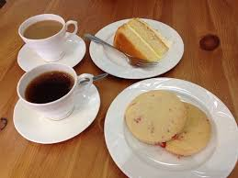
Our Fellowship Continues apart
If you are available, please feel free to remain online to chat.

