Slide 1
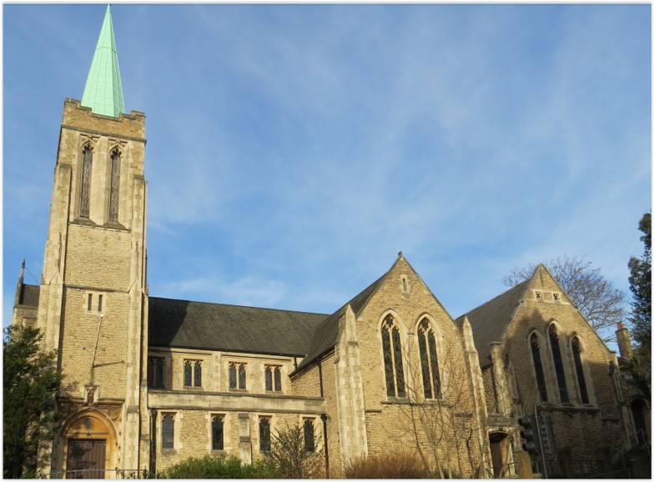
Entry of the Bible. Welcome and notices
Introit. Call to worship
Hymn 590 In heavenly love abiding
Prayers of Approach, confession & assurance of forgiveness
Introduction to today’s theme
Hymn 349 I heard the voice of Jesus
Reading: Matthew 21: 1-9
Choir Anthem
Reading: Philippians 2: 1-13
Hymn 474 Brother, sister, let me serve you
Sermon
Hymn 380 Christ whose glory fills the skies
Prayers of Thanksgiving and Intercession
Blessing the Offering & the Lord’s Prayer
Hymn 521 Forth in thy name
Blessing. Sung Amen.
Readings: NRSV
All hymns are from Rejoice and Sing. CCLI 1239051
St Andrew’s URC Frognal
27 September 2026 11:00am
Leader: Rev Claire Wilson

Slide 2
Entry of the Bible
Welcome and Notices
Introit
Call to worship

Slide 3
Hymn 590 In heavenly love abiding
¹ In heavenly love abiding,
no change my heart shall fear;
and safe is such confiding,
for nothing changes here:
the storm may roar without me,
my heart may low be laid;
but God is round about me,
and can I be dismayed?

Slide 4
² Wherever he may guide me,
no want shall turn me back;
my Shepherd is beside me,
and nothing can I lack:
his wisdom ever waketh, his sight is never dim,
he knows the way he taketh, and I will walk with him.
³ Green pastures are before me,
which yet I have not seen;
bright skies will soon be o'er me,
where darkest clouds have been;
my hope I cannot measure, my path to life is free;
my Saviour has my treasure, and he will walk with me.

Slide 5
Prayers of Approach, confession & assurance of forgiveness
Introduction to today’s theme

Slide 6
Hymn 349 I heard the voice of Jesus say
¹ I heard the voice of Jesus say,
“Come unto Me and rest;
Lay down, thou weary one, lay down
Thy head upon My breast.”
I came to Jesus as I was,
Weary and worn and sad;
I found in Him a resting place,
And He has made me glad

Slide 7
² I heard the voice of Jesus say,
“Behold, I freely give the living water;
thirsty one,
Stoop down, and drink, and live.”
I came to Jesus, and I drank of that life-giving stream;
My thirst was quenched, my soul revived,
And now I live in Him.

Slide 8
³ I heard the voice of Jesus say,
“I am this dark world’s Light; look unto Me, thy morn shall rise,
And all thy day be bright.”
I looked to Jesus, and I found in Him my Star, my Sun;
And in that light of life I’ll walk,
Till travelling days are done.

Slide 9
Matthew 21:1-9
The Triumphant Entry into Jerusalem
¹ As Jesus and his disciples approached Jerusalem, they came to Bethphage at the Mount of Olives. There Jesus sent two of the disciples on ahead ² with these instructions: “Go to the village there ahead of you, and at once you will find a donkey tied up with her colt beside her. Untie them and bring them to me. ³ And if anyone says anything, tell him, ‘The Master needs them’; and then he will let them go at once.”

Slide 10
⁴ This happened in order to make come true what the prophet had said:
⁵ “Tell the city of Zion,
Look, your king is coming to you!
He is humble and rides on a donkey
and on a colt, the foal of a donkey.”
⁶ So the disciples went and did what Jesus had told them to do: ⁷ they brought the donkey and the colt, threw their cloaks over them, and Jesus got on.

Slide 11
⁸ A large crowd of people spread their cloaks on the road while others cut branches from the trees and spread them on the road. ⁹ The crowds walking in front of Jesus and those walking behind began to shout, “Praise to David's Son! God bless him who comes in the name of the Lord! Praise be to God!”

Slide 12
Anthem

Slide 13
Philippians 2:1-13
Imitating Christ’s Humility
¹ If then there is any encouragement in Christ, any consolation from love, any sharing in the Spirit, any compassion and sympathy, ² make my joy complete: be of the same mind, having the same love, being in full accord and of one mind. ³ Do nothing from selfish ambition or conceit, but in humility regard others as better than yourselves.

Slide 14
⁴ Let each of you look not to your own interests, but to the interests of others. ⁵ Let the same mind be in you that was in Christ Jesus,
⁶ who, though he was in the form of God,
did not regard equality with God
as something to be exploited,
⁷ but emptied himself,
taking the form of a slave,
being born in human likeness.
And being found in human form,

Slide 15
⁸ he humbled himself
and became obedient to the point of death—
even death on a cross.
⁹ Therefore God also highly exalted him
and gave him the name
that is above every name,
¹⁰ so that at the name of Jesus
every knee should bend,
in heaven and on earth and under the earth,

Slide 16
¹¹ and every tongue should confess
that Jesus Christ is Lord,
to the glory of God the Father.
Shining as Lights in the World
¹² Therefore, my beloved, just as you have always obeyed me, not only in my presence, but much more now in my absence, work out your own salvation with fear and trembling; ¹³ for it is God who is at work in you, enabling you both to will and to work for his good pleasure.

Slide 17
Hymn 474 Brother, sister, let me serve you
¹ Brother, sister, let me serve you,
let me be as Christ to you;
pray that I may have the grace to
let you be my servant too.
² We are pilgrims on a journey,
and companions on the road;
we are here to help each other
walk the mile and bear the load.

Slide 18
³ I will hold the Christ-light for you
in the night time of your fear;
I will hold my hand out to you,
speak the peace you long to hear.
⁴ I will weep when you are weeping;
I will share your joy and sorrow
when you laugh, I’ll laugh with you;
till we’ve seen the journey through

Slide 19
⁵ When we sing to God in heaven
we shall find such harmony,
born of all we’ve known together
of Christ’s love and agony.
⁶ Brother, sister, let me serve you,
let me as Christ to you;
pray that I may have the grace to
let you be my servant too.

Slide 20
Sermon

Slide 21
Hymn 380 Christ, whose glory fills the skies
¹ Christ, whose glory fills the skies,
Christ, the true, the only light,
Sun of Righteousness, arise,
Triumph o’er the shades of night:
Day-spring from on high, be near:
Day-star, in my heart appear.

Slide 22
² Dark and cheerless is the morn
Unaccompanied by thee,
Joyless is the day’s return,
Till thy mercy’s beams I see;
Till thy inward light impart,
Glad my eyes, and warm my heart.

Slide 23
³ Visit then this soul of mine,
Pierce the gloom of sin, and grief,
Fill me, Radiancy Divine,
Scatter all my unbelief,
More and more thyself display,
Shining to the perfect day.

Slide 24
Prayers of Thanksgiving and Intercession
Blessing the Offering & the Lord’s Prayer

Slide 25
Hymn 521 Forth in thy name, O Lord, I go
¹ Forth in thy name, 0 Lord, I go,
my daily labour to pursue,
thee, only thee, resolved to know
in all I think or speak or do.
² The task thy wisdom hath assigned
O let me cheerfully fulfil!
In all my works thy presence find,
and prove thy good and perfect will.

Slide 26
³ Thee may I set at my right hand,
whose eyes my inmost substance see,
and labour on at thy command,
and offer all my works to thee.
⁴ Give me to bear thine easy yoke,
and every moment watch and pray,
and still to things eternal look,
and hasten to thy glorious day;.

Slide 27
⁵ for thee delightfully employ
whate'er thy bounteous grace hath given,
and run my course with even joy,
and closely walk with thee to heaven.

Slide 28
Blessing.
Sung Amen.
If you are available, please feel free to remain online to chat for fellowship.

Slide 29
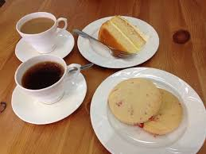
Our Fellowship Continues apart
If you are available, please feel free to remain online to chat.

