Slide 1
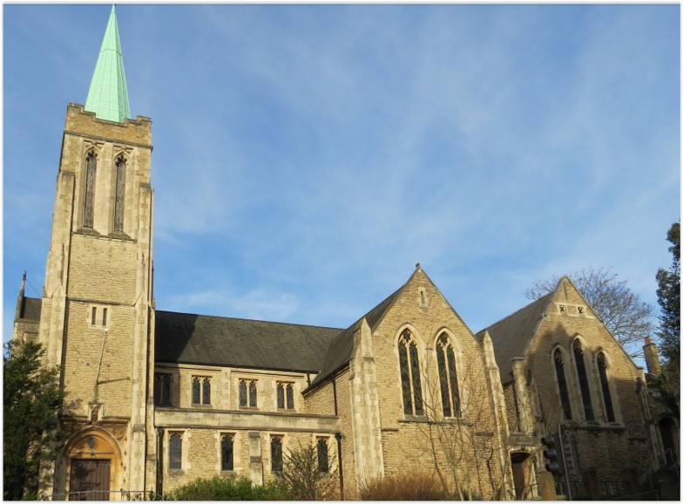
Entry of the Bible. Welcome and notices
Introit. Call to worship.
Hymn 383 Come, let us with our Lord arise
Prayers of approach and confession
Introduction
Hymn 200 The Kingdom of God is justice and joy
Reading: Matthew Ch 21 v 33-46
Hymn 716 (Psalm 103)
Reading: Philippians Ch 3 v 4b-14
Anthem
Sermon
Hymn 349 I heard the voice of Jesus say
Prayers of intercession
Blessing of the offerings
The Lord’s Prayer
Hymn 573 God is working his purpose out
Blessing. Sung Amen.
Readings: NRSV
All hymns are from Rejoice and Sing. CCLI 1239051
St Andrew’s URC Frognal
4 October 2026 11:00am
Leader: Andrew Glennie

Slide 2
Entry of the Bible
Welcome and Notices
Introit
Call to worship

Slide 3
Hymn 383 Come, let us with our Lord arise
¹ Come, let us with our Lord arise,
our Lord, who made both earth and skies;
who died to save the world he made,
and rose triumphant from the dead;
he rose, the Prince of life and peace,
and stamped the day forever his.

Slide 4
² This is the day the Lord has made,
that all may see his love displayed,
may feel his resurrection's power,
and rise again, to fall no more,
in perfect righteousness renewed,
and filled with all the life of God.

Slide 5
³ Then let us render him his own,
with solemn prayer approach his throne,
with meekness hear the gospel word,
with thanks his dying love record,
our joyful hearts and voices raise,
and fill his courts with songs of praise.

Slide 6
Prayers of approach and confession
Introduction

Slide 7
Hymn 200 / 638 Thy Kingdom come, O God
¹ The kingdom of God is justice and joy;
For Jesus restores what sin would destroy.
God’s power and glory in Jesus we know;
And here and hearafter the kingdom shall grow.
² The kingdom of God is mercy and grace;
The captives are freed, the sinners find place,
The outcast are welcomed God’s banquet to share;
And hope is awakened in place of despair.

Slide 8
³ The kingdom of God is challenge and choice:
Believe the good news, repent and rejoice!
God’s love for us sinners brought Christ to his cross:
Our crisis of judgement for gain or for loss.
⁴ God’s kingdom is come, the gift and the goal;
In Jesus begun, in heaven made whole.
The heirs of the kingdom shall answer his call;
And all things cry “Glory” to God all in all.

Slide 9
Matthew 21:33-46
The Parable of the Wicked Tenants
³³ ‘Listen to another parable. There was a landowner who planted a vineyard, put a fence around it, dug a wine press in it, and built a watch-tower. Then he leased it to tenants and went to another country. ³⁴ When the harvest time had come, he sent his slaves to the tenants to collect his produce. ³⁵ But the tenants seized his slaves and beat one, killed another, and stoned another.

Slide 10
³⁶ Again he sent other slaves, more than the first; and they treated them in the same way. ³⁷ Finally he sent his son to them, saying, “They will respect my son.” ³⁸ But when the tenants saw the son, they said to themselves, “This is the heir; come, let us kill him and get his inheritance.” ³⁹ So they seized him, threw him out of the vineyard, and killed him. ⁴⁰ Now when the owner of the vineyard comes, what will he do to those tenants?’

Slide 11
⁴¹ They said to him, ‘He will put those wretches to a miserable death, and lease the vineyard to other tenants who will give him the produce at the harvest time.’ ⁴² Jesus said to them, ‘Have you never read in the scriptures:
“The stone that the builders rejected
has become the cornerstone;
this was the Lord’s doing,
and it is amazing in our eyes”?

Slide 12
⁴³ Therefore I tell you, the kingdom of God will be taken away from you and given to a people that produces the fruits of the kingdom. ⁴⁴ The one who falls on this stone will be broken to pieces; and it will crush anyone on whom it falls.’ ⁴⁵ When the chief priests and the Pharisees heard his parables, they realized that he was speaking about them. ⁴⁶ They wanted to arrest him, but they feared the crowds, because they regarded him as a prophet.

Slide 13
Hymn 716 Psalm 103
¹ My soul, repeat his praise,
Whose mercies are so great,
Whose anger is so slow to rise,
So ready to abate.
² High as the heavens are raised
above the ground we tread,
So far the riches of his grace
Our highest thoughts exceed.

Slide 14
³ His power subdues our sins;
And his forgiving love,
far as the east is from the west,
Doth all our guilt remove.
⁴ The pity of the Lord
To those that fear his name,
Is such as tender parents feel;
He knows our feeble frame.

Slide 15
⁵ Our days are as the grass,
Or like the morning flower;
If one sharp blast sweep o’er the field,
It withers in an hour.
6 But thy compassions, Lord,
To endless years endure,
And children’s children ever find
Thy words of promise sure.

Slide 16
Philippians 3: 4b-14
^{4b} I, too, have reason for confidence in the flesh.
If anyone else has reason to be confident in the flesh, I have more: ⁵ circumcised on the eighth day, a member of the people of Israel, of the tribe of Benjamin, a Hebrew born of Hebrews; as to the law, a Pharisee; ⁶ as to zeal, a persecutor of the church; as to righteousness under the law, blameless. ⁷ Yet whatever gains I had, these I have come to regard as loss because of Christ.

Slide 17
⁸ More than that, I regard everything as loss because of the surpassing value of knowing Christ Jesus my Lord. For his sake I have suffered the loss of all things, and I regard them as rubbish, in order that I may gain Christ ⁹ and be found in him, not having a righteousness of my own that comes from the law, but one that comes through faith in Christ, the righteousness from God based on faith. ¹⁰ I want to know Christ and the power of his resurrection and the sharing of his sufferings by becoming like him in his death, ¹¹ if somehow I may attain the resurrection from the dead.

Slide 18
Pressing towards the Goal
¹² Not that I have already obtained this or have already reached the goal; but I press on to make it my own, because Christ Jesus has made me his own. ¹³ Beloved, I do not consider that I have made it my own; but this one thing I do: forgetting what lies behind and straining forward to what lies ahead, ¹⁴ I press on towards the goal for the prize of the heavenly call of God in Christ Jesus.

Slide 19
Anthem
Sermon

Slide 20
Hymn 349 I heard the voice of Jesus say
¹ I heard the voice of Jesus say,
“Come unto Me and rest;
Lay down, thou weary one, lay down
Thy head upon My breast.”
I came to Jesus as I was,
Weary and worn and sad;
I found in Him a resting place,
And He has made me glad

Slide 21
² I heard the voice of Jesus say,
“Behold, I freely give the living water;
thirsty one,
Stoop down, and drink, and live.”
I came to Jesus, and I drank of that life-giving stream;
My thirst was quenched, my soul revived,
And now I live in Him.

Slide 22
³ I heard the voice of Jesus say,
“I am this dark world’s Light; look unto Me, thy morn shall rise,
And all thy day be bright.”
I looked to Jesus, and I found in Him my Star, my Sun;
And in that light of life I’ll walk,
Till travelling days are done.

Slide 23
Prayers of intercession
Blessing of the offerings
The Lord’s Prayer

Slide 24
Hymn 573 God is working his purpose out
¹ God is working his purpose out
as year succeeds to year:
God is working his purpose out,
and the time is drawing near;
nearer and nearer draws the time,
the time that shall surely be,
when the earth shall be filled
with the glory of God
as the waters cover the sea.

Slide 25
² From utmost east to utmost west,
wherever foot hath trod,
by the mouth of many messengers
goes forth the voice of God;
give ear to me, ye continents,
the islands, give ear to me,
that earth may be filled
with the glory of God
as the waters cover the sea.

Slide 26
³ What can we do to work God's work,
to prosper and increase
love and justice throughout the world--
the reign of the Prince of Peace?
What can we do to hasten the time--
the time that shall surely be,
when the earth shall be filled
with the glory of God
as the waters cover the sea.

Slide 27
⁴ Let us go in the strength of God,
with the banner of Christ unfurled,
that the light of the glorious gospel of truth
may shine throughout the world:
sin and sorrow let us fight
to set their captives free,
that earth may filled
with the glory of God
as the waters cover the sea.

Slide 28
⁵ All we can do is nothing worth
unless God blessed the deed;
vainly we hope for the harvest-tide
till God awakens the seed;
yet nearer and nearer draws the time,
the time that shall surely be,
when the earth shall be filled
with the glory of God
as the waters cover the sea.

Slide 29
Blessing.
Sung Amen.
If you are available, please feel free to remain online to chat for fellowship.

Slide 30
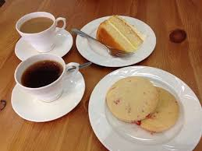
Our Fellowship Continues apart
If you are available, please feel free to remain online to chat.

