Slide 1
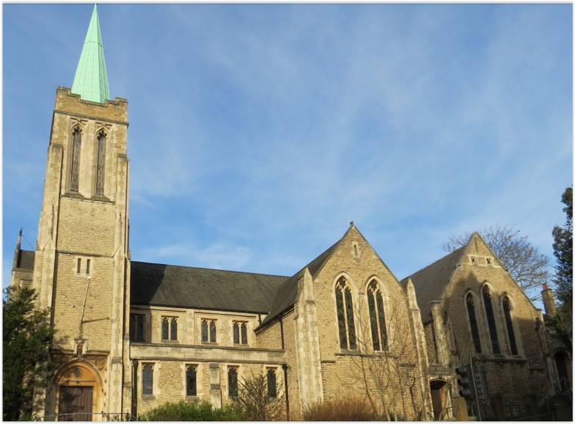
Entry of the Bible. Welcome and notices
Introit. Call to worship
Hymn 332 Jusu lover of my soul
Prayers of Approach, confession & assurance of forgiveness
Introduction to today’s theme
Hymn 371 Take my life
Reading: Mark 10: 17-31
Choir Anthem
Reading: Philippians 4: 4-9
Hymn 448 Awake our souls
Sermon
Hymn 543 Lead us, heavenly Father
Prayers of Thanksgiving and Intercession
Blessing the Offering & the Lord’s Prayer
Hymn 582 Thanks be to God
Blessing. Sung Amen.
Readings: NRSV
All hymns are from Rejoice and Sing. CCLI 1239051
St Andrew’s URC Frognal
11 October 2026 11:00am
Leader: Rev Claire Wilson

Slide 2
Entry of the Bible
Welcome and Notices
Introit
Call to worship

Slide 3
Hymn 332 Jesus, lover of my soul
¹ Jesus, lover of my soul,
let me to thy bosom fly,
while the nearer waters roll,
while the tempest still is high.
Hide me, O my Saviour, hide,
till the storm of life is past;
safe into the haven guide;
O receive my soul at last.

Slide 4
² Other refuge have I none,
hangs my helpless soul on thee;
leave, ah! leave me not alone,
still support and comfort me.
All my trust on thee is stayed,
all my help from thee I bring;
cover my defenseless head
with the shadow of thy wing.

Slide 5
³ Thou, O Christ, art all I want,
more than all in thee I find;
raise the fallen, cheer the faint,
heal the sick, and lead the blind.
Just and holy is thy name,
I am all unrighteousness;
false and full of sin I am;
thou art full of truth and grace.

Slide 6
⁴ Plenteous grace with thee is found,
grace to cover all my sin;
let the healing streams abound,
make and keep me pure within.
Thou of life the fountain art,
freely let me take of thee;
spring thou up within my heart;
rise to all eternity.

Slide 7
Prayers of Approach, confession & assurance of forgiveness
Introduction to today’s theme

Slide 8
Hymn 371 Take my life, and let it be
¹ Take my life and let it be
consecrated, Lord, to thee.
Take my moments and my days;
let them flow in endless praise,
let them flow in endless praise.

Slide 9
² Take my hands and let
them move
at the impulse of thy love.
Take my feet and let them be
swift and beautiful for thee,
swift and beautiful for thee.

Slide 10
³ Take my voice and let me sing
always, only, for my King.
Take my lips and let them be
filled with messages from thee,

Slide 11
⁴ Take my silver and my gold;
not a mite would I withhold.
Take my intellect and use
every power as thou shalt choose.

Slide 12
⁵ Take my will and make it thine;
it shall be no longer mine.
Take my heart it is thine own;
it shall be thy royal throne.

Slide 13
⁶ Take my love; my Lord, I pour
at thy feet its treasure store.
Take myself, and I will be
ever, only, all for thee.

Slide 14
Mark 10: 17-31
The Rich Man
¹⁷ As he was setting out on a journey, a man ran up and knelt before him, and asked him, ‘Good Teacher, what must I do to inherit eternal life?’ ¹⁸ Jesus said to him, ‘Why do you call me good? No one is good but God alone. ¹⁹ You know the commandments: “You shall not murder; You shall not commit adultery; You shall not steal; You shall not bear false witness; You shall not defraud; Honour your father and mother.”’ ²⁰ He said to him, ‘Teacher, I have kept all these since my youth.’

Slide 15
²¹ Jesus, looking at him, loved him and said, ‘You lack one thing; go, sell what you own, and give the money to the poor, and you will have treasure in heaven; then come, follow me.’ ²² When he heard this, he was shocked and went away grieving, for he had many possessions. ²³ Then Jesus looked around and said to his disciples, ‘How hard it will be for those who have wealth to enter the kingdom of God!’ ²⁴ And the disciples were perplexed at these words. But Jesus said to them again, ‘Children, how hard it is to enter the kingdom of God! ²⁵ It is easier for a camel to go through the eye of a needle than for someone who is rich to enter the kingdom of God.’

Slide 16
²⁶ They were greatly astounded and said to one another, ‘Then who can be saved?’ ²⁷ Jesus looked at them and said, ‘For mortals it is impossible, but not for God; for God all things are possible.’ ²⁸ Peter began to say to him, ‘Look, we have left everything and followed you.’ ²⁹ Jesus said, ‘Truly I tell you, there is no one who has left house or brothers or sisters or mother or father or children or fields, for my sake and for the sake of the good news, ³⁰ who will not receive a hundredfold now in this age - houses, brothers and sisters, mothers and children, and fields, with persecutions - and in the age to come eternal life. ³¹ But many who are first will be last, and the last will be first.’

Slide 17
Choir Anthem

Slide 18
Philippians 4:4-9
⁴ Rejoice in the Lord always; again I will say, Rejoice. ⁵ Let your gentleness be known to everyone. The Lord is near. ⁶ Do not worry about anything, but in everything by prayer and supplication with thanksgiving let your requests be made known to God. ⁷ And the peace of God, which surpasses all understanding, will guard your hearts and your minds in Christ Jesus.

Slide 19
⁸ Finally, beloved, whatever is true, whatever is honourable, whatever is just, whatever is pure, whatever is pleasing, whatever is commendable, if there is any excellence and if there is anything worthy of praise, think about these things. ⁹ Keep on doing the things that you have learned and received and heard and seen in me, and the God of peace will be with you.

Slide 20
Hymn 378 Awake, my soul, and with the sun
¹ Awake, my soul, and with the sun
Thy daily stage of duty run;
Shake off dull sloth, and joyful rise
To pay thy morning sacrifice.
² By influence of Light divine
Let thine own light to others shine.
Reflect all Heaven’s propitious ways
In ardent love, and cheerful praise.

Slide 21
³ Wake, and lift up thyself, my heart,
And with the angels bear thy part,
Who all night long unwearied sing
High praise to the eternal King.
⁴ Lord, I my vows to Thee renew;
Disperse my sins as morning dew.
Guard my first springs of thought and will,
And with Thyself my spirit fill.

Slide 22
⁵ Direct, control, suggest, this day,
All I design, or do, or say,
That all my powers, with all their might,
In Thy sole glory may unite.
⁶ Praise God, from Whom all blessings flow!
Praise Him, all creatures here below!
Praise Him above, ye heavenly host!
Praise Father, Son, and Holy Ghost!

Slide 23
Sermon

Slide 24
Hymn 543 Lead us, heavenly Father
¹ Lead us, heavenly Father, lead us
o'er the world's tempestuous sea;
guard us, guide us, keep us, feed us,
for we have no help but thee;
yet possessing every blessing
if our God our Father be.

Slide 25
² Saviour, breathe forgiveness o'er us;
all our weakness thou dost know,
thou didst tread this earth before us,
thou didst feel its keenest woe; ·
lone and dreary, faint and weary,
through the desert thou didst go.

Slide 26
³ Spirit of our God, descending,
fill our hearts with heavenly joy,
love with every passion blending,
pleasure that can never cloy:
thus provided, pardoned, guided,
nothing can our peace destroy.

Slide 27
Prayers of Thanksgiving and Intercession
Blessing the Offering & the Lord’s Prayer

Slide 28
Hymn 582 Thanks be to God
¹ Thanks be to God, whose Church on earth
has stood the tests of time and place,
and everywhere proclaims new birth
through Christ whose love reveals God's face.
² Thanks be to God, whose Spirit sent
apostles out upon his way;
from east to west the message went;
on Greek and Roman dawned the day.

Slide 29
³ Thanks be to God, whose later voice
from west to east sent back the word
which, through the servants of his choice,
at last in every tongue was heard.
⁴ Thanks be to God who now would reach
his listeners in more global ways;
now each will send the news, and each
receive and answer it in praise.
⁵ Thanks be to God, in whom we share
today the mission of his Son;
may all his Church that time prepare
when, like the task, the world is one.

Slide 30
Blessing.
Sung Amen.
If you are available, please feel free to remain online to chat for fellowship.

Slide 31
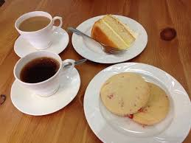
Our Fellowship Continues apart
If you are available, please feel free to remain online to chat.

