Slide 1
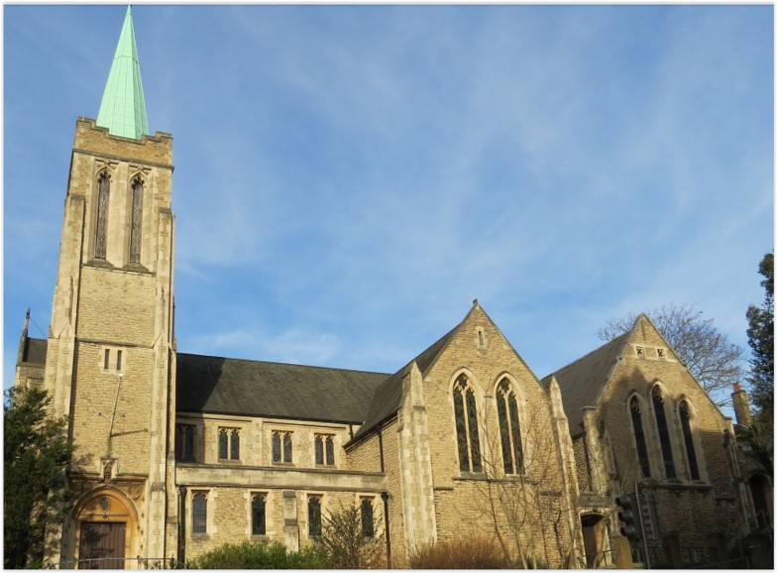
Entry of the Bible. Welcome and notices
Introit. Call to worship.
Hymn 382 Come, let us join our cheerful songs
Prayers of approach and confession
Introduction
Hymn 570 A glorious company we sing
Reading: Revelation Ch 7 v 9-17
Hymn 685 (Psalm 34)
Reading: 1 John CH 3 v 1-3
Anthem
Sermon
Hymn 484 We come unto our faithful God
Prayers of intercession
Blessing of the offerings
The Lord’s Prayer
Hymn 658 For all the saints
Blessing. Sung Amen.
Readings: NRSV
All hymns are from Rejoice and Sing. CCLI 1239051
St Andrew’s URC Frognal
1 November 2026 11:00am
Leader: Andrew Glennie

Slide 2
Entry of the Bible
Welcome and Notices
Introit
Call to worship

Slide 3
Hymn 382 Come, let us join our cheerful songs
1 Come, let us join our cheerful songs
with angels round the throne;
ten thousand thousand are their tongues,
but all their joys are one.

Slide 4
² 'Worthy the Lamb that died,' they cry,
to be exalted thus;
worthy the Lamb, our lips reply,
for he was slain for us.
³ Jesus is worthy to receive
honour and power divine;
and blessings, more than we can give,
be, Lord, for ever thine.

Slide 5
⁴ Let all the hosts of heaven combine
and air and earth and sea,
to lift in glorious songs divine
their endless praise to thee.
⁵ Let all creation joins in one
to bless the sacred name
of him that sits upon the throne,
and to adore the Lamb.

Slide 6
Prayers of approach and confession
Introduction

Slide 7
Hymn 570 A glorious company we sing
¹ A glorious company we sing,
The Master and his friends,
He sent them forth to tell his love,
And all his love intends.
² A faithful company we sing,
The steadfast martyr hand;
For Christ and for his kingdom’s cause
They boldly made their stand.

Slide 8
³ A love company we sing,
Whom Jesus sent to save
The sick, the hungry and the blind,
The outcase and the slave.
⁴ We joing this glorious company
Of Jesus and his friends,
To spread throughout this troubled world
His love that never ends.

Slide 9
Revelation 7:9-17
The multitude from every nation
⁹ After this I looked, and there was a great multitude that no one could count, from every nation, from all tribes and peoples and languages, standing before the throne and before the Lamb, robed in white, with palm branches in their hands. ¹⁰ They cried out in a loud voice, saying,
‘Salvation belongs to our God who is seated on the throne, and to the Lamb!’

Slide 10
¹¹ And all the angels stood around the throne and around the elders and the four living creatures, and they fell on their faces before the throne and worshipped God, ¹² singing,
‘Amen! Blessing and glory and wisdom
and thanksgiving and honour
and power and might
be to our God for ever and ever! Amen.’

Slide 11
¹³ Then one of the elders addressed me, saying, ‘Who are these, robed in white, and where have they come from?’ ¹⁴ I said to him, ‘Sir, you are the one that knows.’ Then he said to me, ‘These are they who have come out of the great ordeal; they have washed their robes and made them white in the blood of the Lamb.

Slide 12
¹⁵ For this reason they are before the throne of God,
and worship him day and night within his temple,
and the one who is seated on the throne will shelter them.

Slide 13
¹⁶ They will hunger no more, and thirst no more; the sun will not strike them,
nor any scorching heat;
¹⁷ for the Lamb at the centre of the throne will be their shepherd,
and he will guide them to springs of the water of life,
and God will wipe away every tear from their eyes.’

Slide 14
Hymn 685 Through all the changing scenes of life
¹ Through all the chang­ing scenes of life,
In trou­ble and in joy,
The prais­es of my God shall still
My heart and tongue em­ploy.
² Of His de­liv­er­ance I will boast,
Till all that are dis­tressed
From my ex­am­ple cour­age take
And soothe their griefs to rest.

Slide 15
³ O mag­ni­fy the Lord with me,
With me ex­alt His name;
When in dis­tress to him I called,
He to my res­cue came.
⁴ O make but tri­al of his love;
Experience will de­cide
How blest are they, and on­ly they,
Who in His truth con­fide.

Slide 16
⁵ Fear Him, ye saints, and you will then
Have no­thing else to fear;
Make you his serv­ice your de­light;
Your wants shall be his care.

Slide 17
1 John 3: 1-3
¹ See what love the Father has given us, that we should be called children of God; and that is what we are. The reason the world does not know us is that it did not know him. ² Beloved, we are God’s children now; what we will be has not yet been revealed. What we do know is this: when he is revealed, we will be like him, for we will see him as he is. ³ And all who have this hope in him purify themselves, just as he is pure.

Slide 18
Anthem
Sermon

Slide 19
Hymn 484 We come unto our faithful God
1 We come unto our fathers’ God:
The Rock of our salvation:
The eternal arms, that sure abode,
We make our habitation:
We seek thee, Lord, the praise they brought;
In every generation.

Slide 20
² The fire divine their steps that led
Still goeth bright before us;
The heavenly shield, around them spread
Is still lifted o’er us;
The grace those sinners that subdued
The strength those weaklings that renewed,
doth vanquish, doth restore us.

Slide 21
³ Their joy unto their Lord we bring;
Their song to us descendeth:
The Spirit Who in them did sing
To us His music lendeth.
His song in them, in us, is one;
We raise it high, we send it on, -
The song that never endeth!

Slide 22
⁴ Ye saints to come, take up the strain,
The same sweet theme endeavour!
Unbroken be the golden chain;
Keep on the song for ever!
Safe in the same dear dwelling-place,
Rich with the same eternal grace,
Bless the same boundless Giver!

Slide 23
Prayers of intercession
Blessing of the offerings
The Lord’s Prayer

Slide 24
Hymn 658 For all the saints
¹ For all the saints who from their labours rest,
who thee by faith before the world confessed,
thy name, O Jesus, be forever blest.
Alleluia! Alleluia!

Slide 25
² Thou wast their rock, their fortress, and their might;
thou, Lord, their captain in the well-fought fight;
thou, in the darkness drear, their one true light.
Alleluia! Alleluia!
³ O may thy servants, faithful, true, and bold,
fight as the saints who nobly fought of old,
and win with them the victor's crown of gold.
Alleluia! Alleluia!

Slide 26
⁴ O blest communion, fellowship divine,
we feebly struggle, they in glory shine;
yet all are one in thee, for all are thine.
Alleluia! Alleluia!
⁵ From earth's wide bounds, from ocean's farthest coast,
through gates of pearl streams in the countless host,
singing to Father, Son, and Holy Ghost,
Alleluia! Alleluia!

Slide 27
Blessing.
Sung Amen.
If you are available, please feel free to remain online to chat for fellowship.

Slide 28
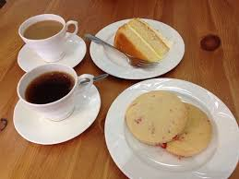
Our Fellowship Continues apart
If you are available, please feel free to remain online to chat.

