Slide 1
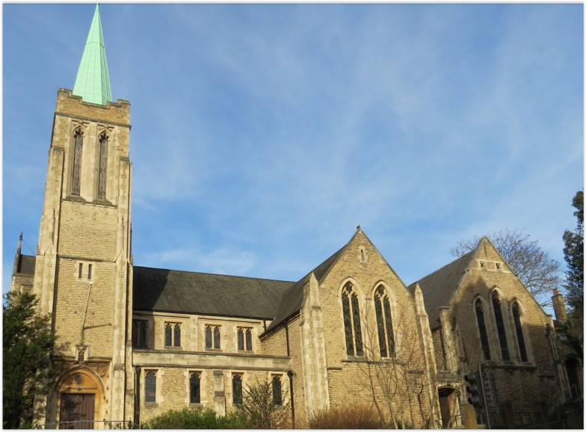
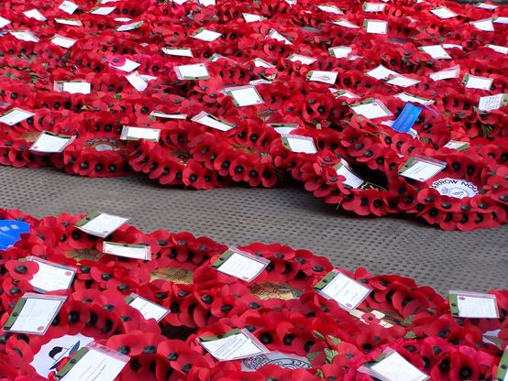
Entry of the Bible. Welcome and notices
Introit. Call to worship
Hymn 161 Our God, our help in ages past
Prayers of approach
Names of the fallen – They shall grow not old….
Last Post Silence Reveille
Hymn 260 Eternal Father strong to save
Introduction
Hymn 702 Lord, in love and perfect wisdom
Reading Matthew 5: 1-12
Choir: Anthem
Reading Psalm 9: 9-20
Sermon
Hymn Jesus came to repair
Prayers for the church & the world
Offertory Prayer & the Lord’s Prayer
Hymn 622 We sing a love that sets all people free
Blessing. Sung Amen
Readings: NRSV
All hymns are from Rejoice & Sing. CCLI 1239051
Remembrance Sunday
8 November 2026
St Andrew’s URC Frognal
Leader Christy Sawyer

Slide 2
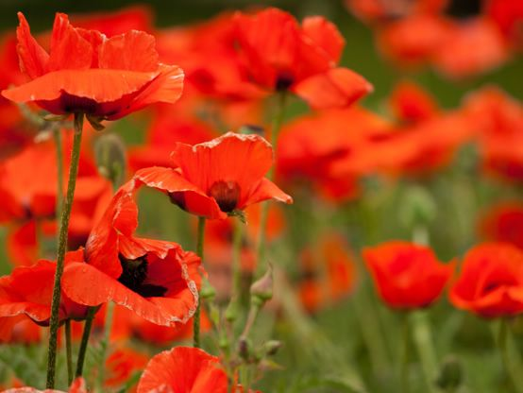
Entry of the Bible
Welcome and Notices
Choir: Introit
Call to Worship

Slide 3
Hymn 705 O God our help in ages past
¹ O God, our help in ages past,
our hope for years to come,
our shelter from the stormy blast,
and our eternal home:
² Under the shadow of thy throne
thy saints have dwelt secure;
sufficient is thine arm alone,
and our defence is sure.

Slide 4
³ Before the hills in order stood,
or earth received her frame,
from everlasting thou art God,
to endless years the same.
⁴ A thousand ages in thy sight
are like an evening gone;
short as the watch that ends the night
before the rising sun.

Slide 5
⁵ Time, like an ever-rolling stream,
bears all its sons away;
they fly forgotten, as a dream
dies at the opening day.
⁶ O God, our help in ages past,
our hope for years to come,
be thou our guard while troubles last,
and our eternal home.

Slide 6
Prayers of approach

Slide 7
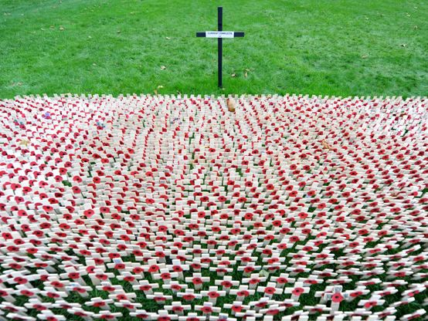
Names of the Fallen
They shall grow not old, as we that are left grow old:
Age shall not weary them, nor the years condemn.
At the going down of the sun and in the morning.
We will remember them.
ALL:
We will remember them.
Last Post
Silence
Reveille

Slide 8
Hymn 58 Eternal Father, strong to save
¹ Eternal Father, strong to save.
Whose arm hath bound the restless wave,
Who bid’st the mighty ocean deep
It’s own appointed limits keep;
O hear us when we cry to thee,
For those in peril on the sea.

Slide 9
² O Christ, the Universal Lord,
Who suffered death by nails and sword,
From all assault of deadly foe
Sustain thy soldiers where they go;
And evermore hold in thy hand
All those in peril on the land.

Slide 10
³ O Holy Spirit, Lord of grace
Who fills with strength the human race.
Inspire mankind to know the right,
Guide all who dare the eagle’s flight;
And underneath thy wings of care
Guard all from peril in the air.

Slide 11
⁴ O Trinity of love and power!
Our brethren shield in danger’s hour;
From rock and tempest, fire and foe,
Protect them whereso’er they go.
Thus, evermore shall rise to thee
Praise from the air, the land and sea.

Slide 12
Introduction

Slide 13
Hymn 702 Lord, in love and perfect wisdom
¹ Lord, in love and perfect wisdom
times and seasons you arrange,
working out your changeless purpose
in a world of ceaseless change;
You have formed our ancient nation,
guiding it through all the days,
to unfold in it your purpose
to your glory and your praise.

Slide 14
² To our shores remote, benighted,
barrier of the western waves,
tidings in your love you sent us,
tidings of the cross that saves.
Saints and heroes strove and suffered
here your gospel to proclaim;
we, the heirs of their endeavour,
tell the honour of their name.

Slide 15
³ You maintain your purpose purpose
every change and chance above;
still your holy Church is bearing
witness to your changeless love.
Grant us vision, Lord, and courage
to fulfil your work begun;
in the Church and in the nation,
King of kings, your will be done.

Slide 16
Matthew 5:1-12
The Beatitudes
¹ When Jesus saw the crowds, he went up the mountain; and after he sat down, his disciples came to him. ² Then he began to speak, and taught them, saying:
³ ‘Blessed are the poor in spirit, for theirs is the kingdom of heaven.
⁴ ‘Blessed are those who mourn, for they will be comforted.

Slide 17
⁵ ‘Blessed are the meek, for they will inherit the earth.
⁶ ‘Blessed are those who hunger and thirst for righteousness, for they will be filled.
⁷ ‘Blessed are the merciful, for they will receive mercy.
⁸ ‘Blessed are the pure in heart, for they will see God.
⁹ ‘Blessed are the peacemakers, for they will be called children of God.
¹⁰ ‘Blessed are those who are persecuted for righteousness’ sake, for theirs is the kingdom of heaven.

Slide 18
¹¹ ‘Blessed are you when people revile you and persecute you and utter all kinds of evil against you falsely on my account. ¹² Rejoice and be glad, for your reward is great in heaven, for in the same way they persecuted the prophets who were before you.

Slide 19
Choir: Anthem

Slide 20
Psalm 9:9-20
⁹ The Lord is a stronghold for the oppressed,
a stronghold in times of trouble.
¹⁰ And those who know your name put their trust in you,
for you, O Lord, have not forsaken those who seek you.
¹¹ Sing praises to the Lord, who dwells in Zion.
Declare his deeds among the peoples.
¹² For he who avenges blood is mindful of them;
he does not forget the cry of the afflicted.
¹³ Be gracious to me, O Lord.
See what I suffer from those who hate me;
you are the one who lifts me up from the gates of death,

Slide 21
¹⁴ so that I may recount all your praises,
and, in the gates of daughter Zion,
rejoice in your deliverance.
¹⁵ The nations have sunk in the pit that they made;
in the net that they hid has their own foot been caught.
¹⁶ The Lord has made himself known, he has executed judgement;
the wicked are snared in the work of their own hands.
Higgaion. Selah

Slide 22
¹⁷ The wicked shall depart to Sheol,
all the nations that forget God.
¹⁸ For the needy shall not always be forgotten,
nor the hope of the poor perish for ever.
¹⁹ Rise up, O Lord! Do not let mortals prevail;
let the nations be judged before you.
²⁰ Put them in fear, O Lord;
let the nations know that they are only human.
Selah

Slide 23
Sermon

Slide 24
Tune: As the deer CH4 550 MP 37 STF 544 SofGHofP 550
Hymn 550 Jesus came to repair
¹ Jesus came to repair what’s broken,
showing love for each and all,
off’ring God’s reconciliation,
gave his life to meet his call.
Help repair broken lives with God,
come, take that road where Christ’s feet have trod,
work to bring reconciliation,
join the bravest work of God.

Slide 25
² In our world there’s so much that’s broken,
crying out for real repair,
needing God’s reconciliation
needing hope and help and care.
Help repair broken lives with God,
come, take that road where Christ’s feet have trod,
work to bring reconciliation,
join the bravest work of God.

Slide 26
³ Israel and the Palestinians
need a new shared way to be,
pray for deep reconciliation
that can rescue and set free.
Help repair broken lives with God,
come, take that road where Christ’s feet have trod,
work to bring reconciliation,
join the bravest work of God.

Slide 27
⁴ Finding grace, finding God’s forgiveness,
is a journey we all share,
we need God’s reconciliation,
truth and justice ev’rywhere!
Help repair broken lives with God,
come, take that road where Christ’s feet have trod,
work to bring reconciliation,
join the bravest work of God.

Slide 28
Prayers for the church & the world
Blessing of the offertory
The Lord’s Prayer

Slide 29
Hymn 622 We sing a love that sets all people free
¹ We sing a love that sets all people free,
that blows like wind, that burns like scorching flame,
enfolds like earth, springs up like water clear:
come, living love, live in our hearts today.
2 We sing a love that seeks another's good,
that longs to serve and not to count the cost,
a love that, yielding, finds itself made new:
come, caring love, live in our hearts today.

Slide 30
Hymn 622 We sing a love that sets all people free
³ We sing a love, unflinching, unafraid
to be itself, despite another's wrath,
a love that stands alone and undismayed:
come, strengthening love, live in our hearts today.
4 We sing a love, that, wandering, will not rest
until it finds its way, its home, its source,
through joy and sadness pressing on refreshed:
come, pilgrim love, live in our hearts today.

Slide 31
Hymn 622 We sing a love that sets all people free
⁵ We sing a burning, fiery, Holy Ghost
that seeks out shades of ancient bitterness,
transfiguring these, as Christ in every heart:
come joyful love, live in our hearts today.

Slide 32
Blessing
Sung Amen

